Slide 1
‘ ‘A time to remember’ A practical framework to support families who have been bereaved.
Wendy Bennett

Slide 2
Aims of this presentation
To explain the bereavement support framework that has been developed across Lancashire and South Cumbria
To discuss ‘A Time to Remember’ memorial service that is held every year
To highlight limitations and recommendations to the field

Slide 3
Our Pioneer Dame Cicely Saunders
‘Bereavement care is considered as important as the support received through the end stages of a person’s life and the memories of this time are crucial in how the carer will cope in bereavement’ (Saunders, 1984)

Slide 4
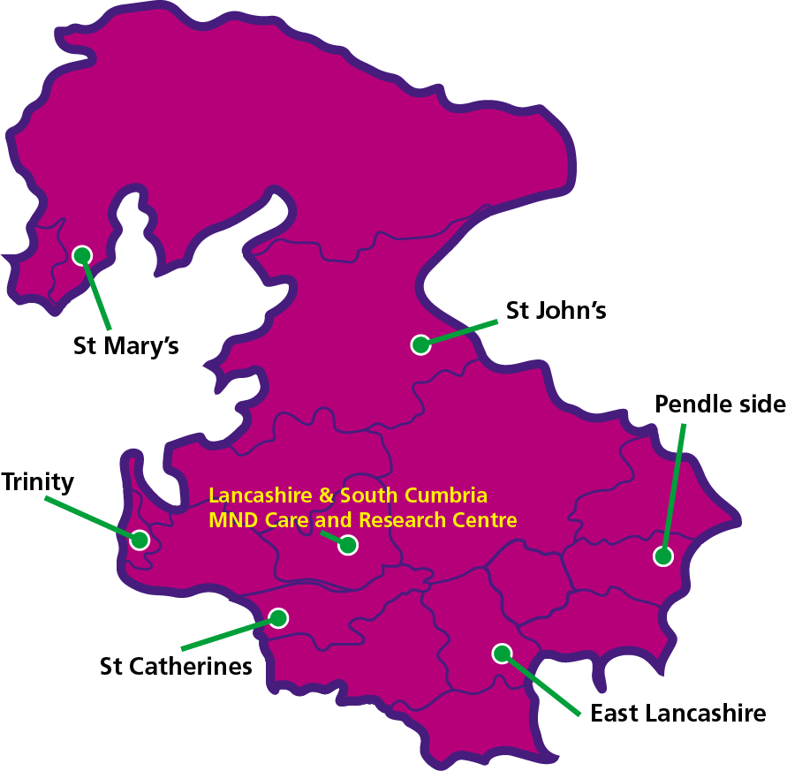
Hospice clinics have been introduced in Lancashire and South Cumbria
Lancashire and South Cumbria: 1.6 million residents. Both Rural and urban areas
Work with Neurologist but we are a nurse led service working closely with palliative care teams
Nurse-led clinics on a 3 monthly basis in the 6 Hospices in our Region
Once patients unable to attend clinic the MND team arrange home visits until their death.

Slide 5
What the Nice Guidelines say about Bereavement support.
The National Institute for Care Excellence (NICE) guidelines for End of Life Care state that the needs of caregivers and family must be met during and after the patient’s death (statement 14, NICE, 2017)
NICE recommends bereavement support may be not be limited to immediately after death, but may be required on a longer-term basis and, in some cases, may begin before death.
Research suggests that continuing emotional support from valued and trusted professionals who were involved in the care or treatment of the patient immediately prior to death can be can be beneficial for bereaved carers (Aoun, Connors, Pridis, Breen, & Collier, 2011)
“there was a whole army of people …. And then it’s just up to you…”

Slide 6
Why do we need to organise care in bereavement?
In 2016 the MND Association published a report in response to the government’s call for evidence on improving support for carers. One aspect of this was about the lack of bereavement support for carers: for example, one carer is cited as saying “I was dropped …..” after the person with MND had died. Another comment was “When they’re alive you are standing on a cliff edge. Where do you go after?”
This report indicated that support was either not there, too late or was extremely limited (The MNDA, 2016).

Slide 7
Whitehead et al. (2011) recognise that carers who have been in a situation of caring for people with MND are often left exhausted physically and mentally and have disregarded their own health for the sake of their loved one.
Aoun et al. (2012) agrees and found MND family carers had little regard for their personal needs such as sleep or recreational activities. These carers often entered bereavement physically and emotionally exhausted

Slide 8
The first 3 months of our bereavement support service
The MND team follow up after death with a phone call and a visit if possible.
A Sympathy card is sent out within one week of bereavement
After 6-8 weeks post bereavement a card and poem are sent to the next of kin

Slide 9
Bereavement support on first anniversary of death
Just before the 12 month anniversary another card is sent with hand written words and another poem.
After this card we often receive an email or phone call to thank the team.

Slide 10
Research to support our bereavement support
Vacha-Haase (2013) found that first week following death was a very emotional one and at this point a card and phone contact were very important. Likewise, between 6-8 weeks following death was the point that the realisation of the loved one’s passing dawned; hence, another card was sent at this point and again at one year following death another card was sent as this was known to be a very difficult time for many bereaved carers.
Both Hottenson (2013) and Vacha-Haase (2013) found that setting up bereavement services for their patients decreased the number of carers suffering from prolonged grief and their services were very well received by grieving carers; for example, one carer said “your care and service did not change when the patient passed away, you have shown great care and compassion for those of us who are left behind….”

Slide 11
Comments from the families about our bereavement support service
“Thank you for the lovely card and little poem. I am going to put the poem into a little frame with a picture of her deceased loved one.” Lots of smiley faces…..
“Hi …. and all the MND team, thank you for the lovely card and poem the poem is spot on every time I see something of Val’s or here something the memories come flooding back. I have good days and bad days but I can always look back on the good days, and that keep me going.“
“ It was so good to receive the cards because it made us realise that you understood how hard it is to lose a loved one to this terrible disease”

Slide 12
More comments
‘I was very touched I didn’t expect it. I felt if someone else genuinely cared’
‘During the first year after bereavement life was a blur and I do not really remember exactly when the cards arrived but I know I was very touched’
‘ Thank you for your pretty little card with your offer of continuing support for the family and me- we do appreciate it!. I don’t know where you got the lovely poem but it brought tears to my eyes and warm thoughts of my wife’

Slide 13
Our annual memorial service
‘A time to remember’

Slide 15
The order of service

Slide 16
‘A time to remember’

Slide 17
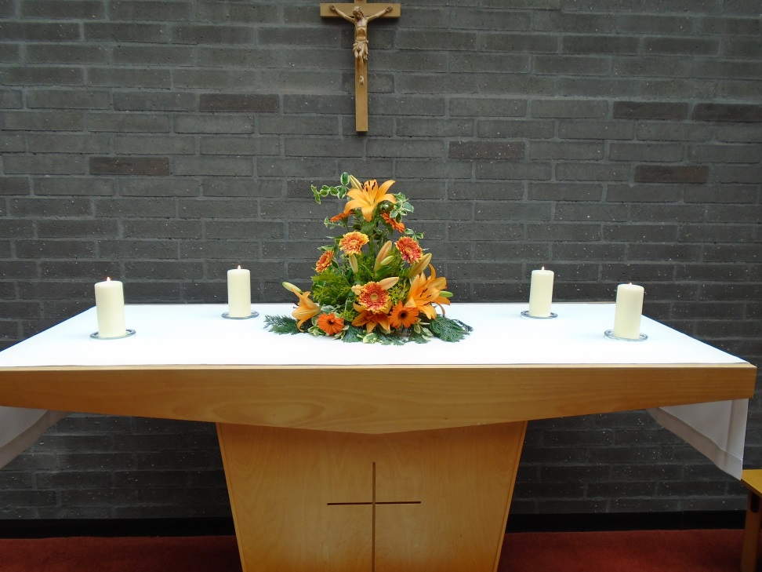
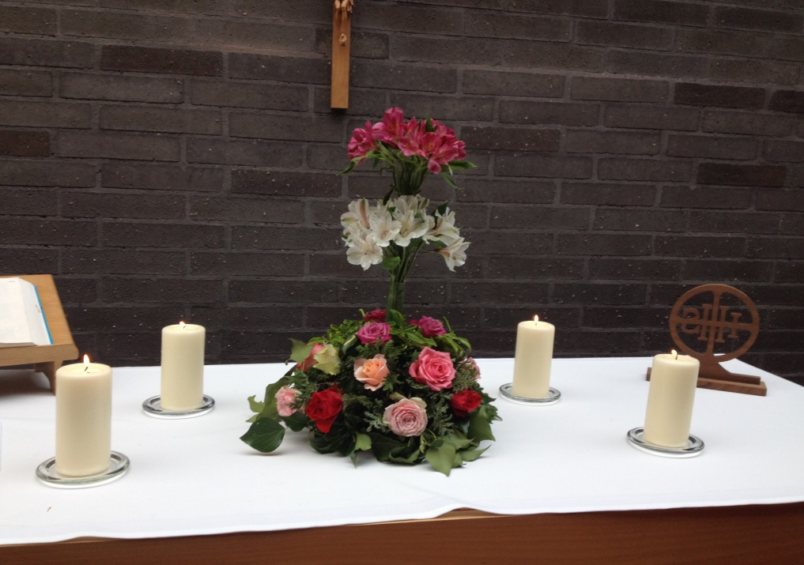

Slide 18
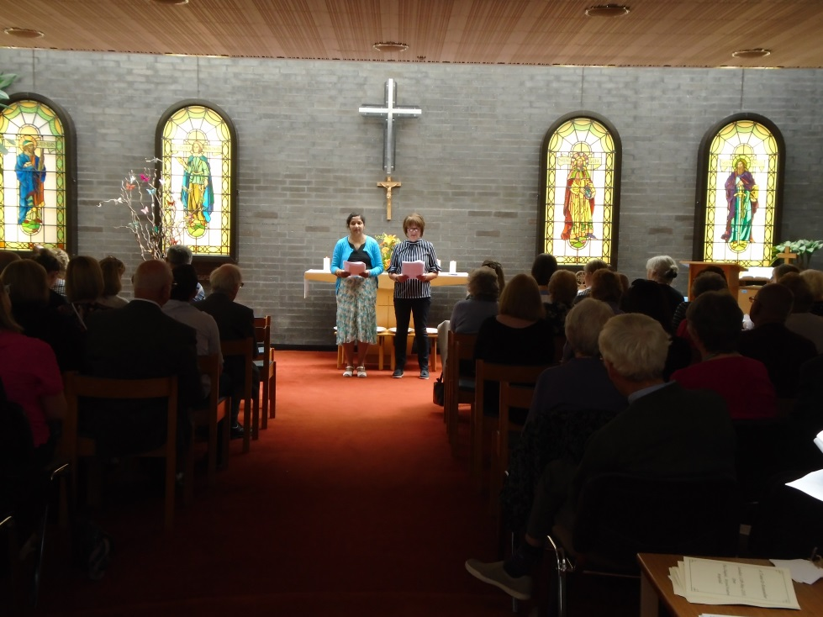
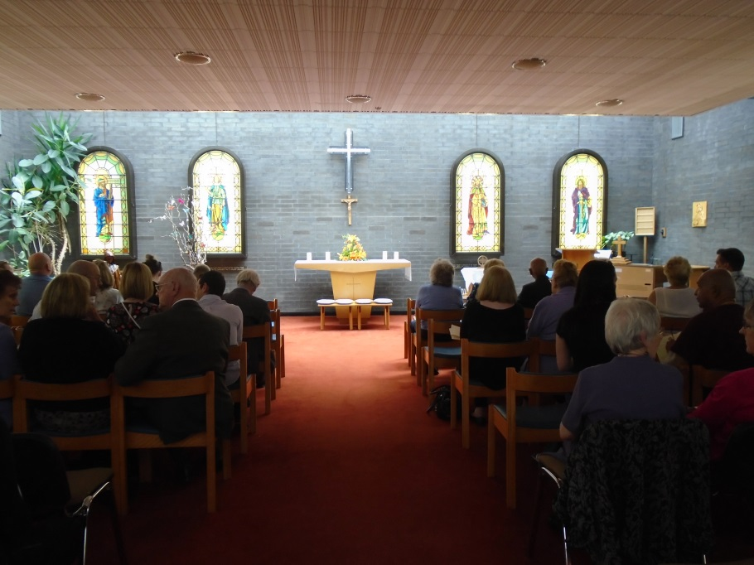
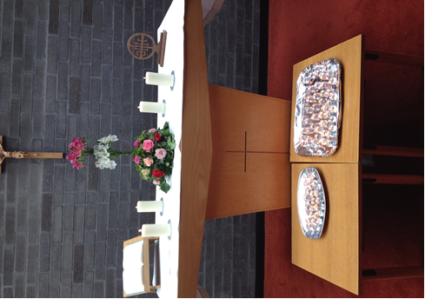
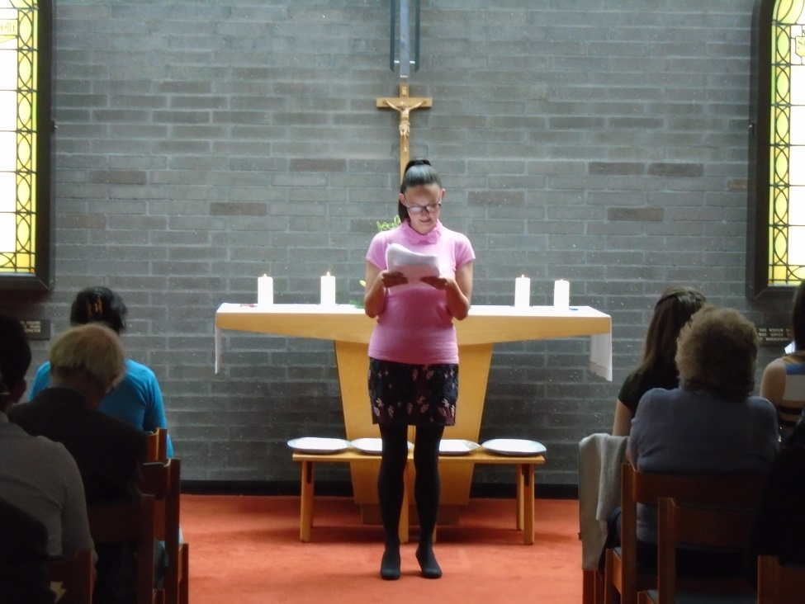

Slide 19
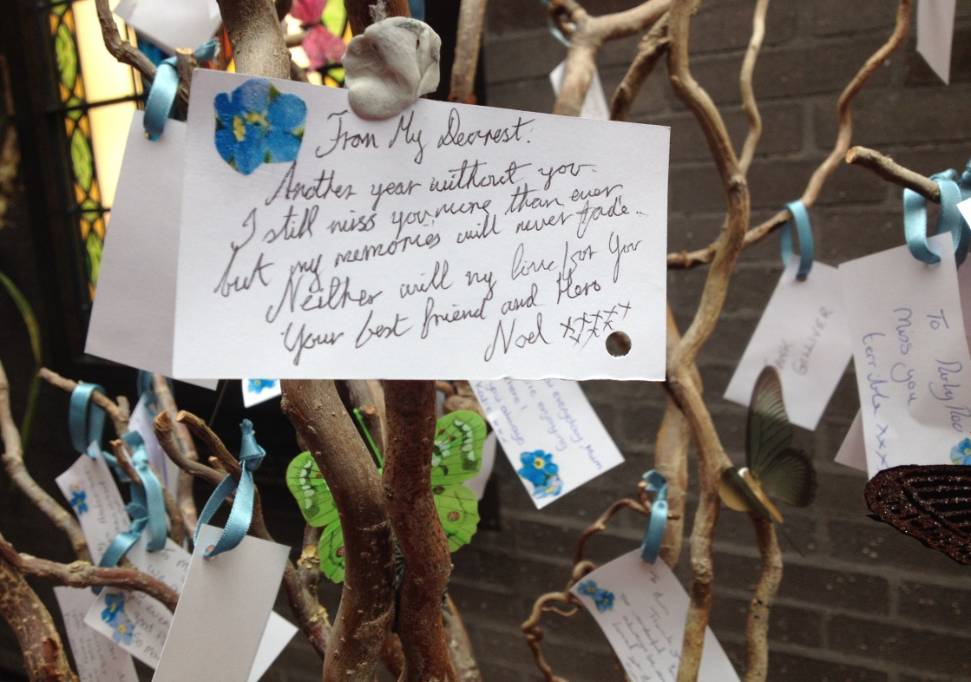
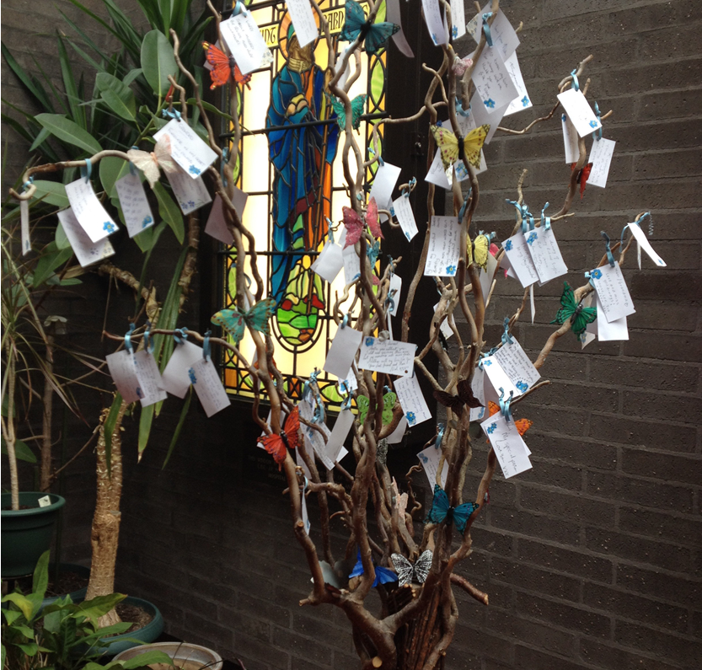
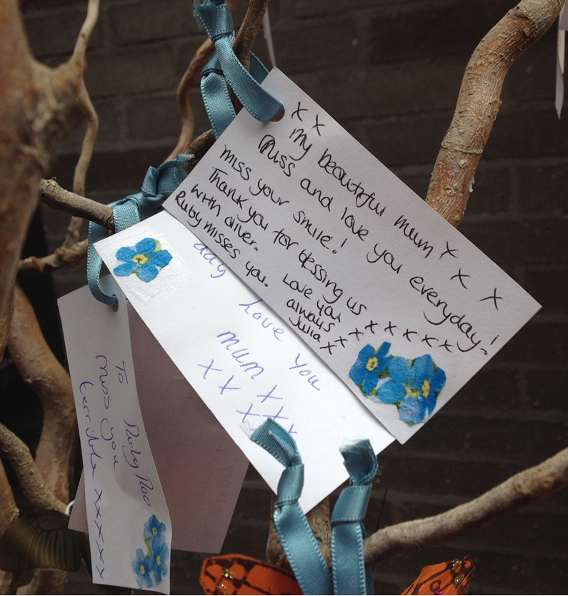

Slide 20
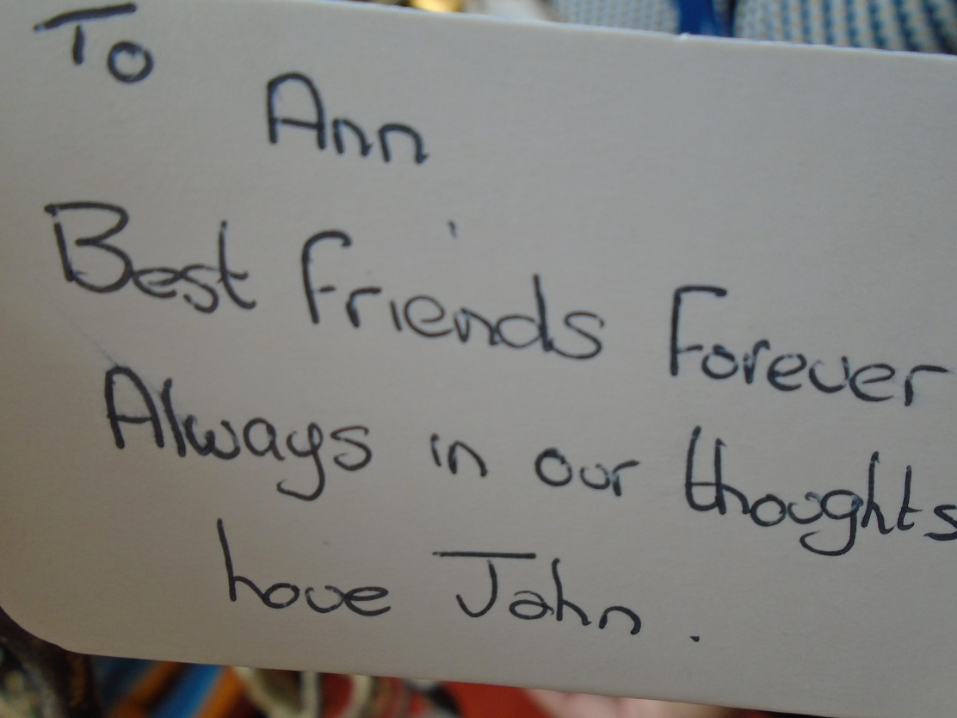
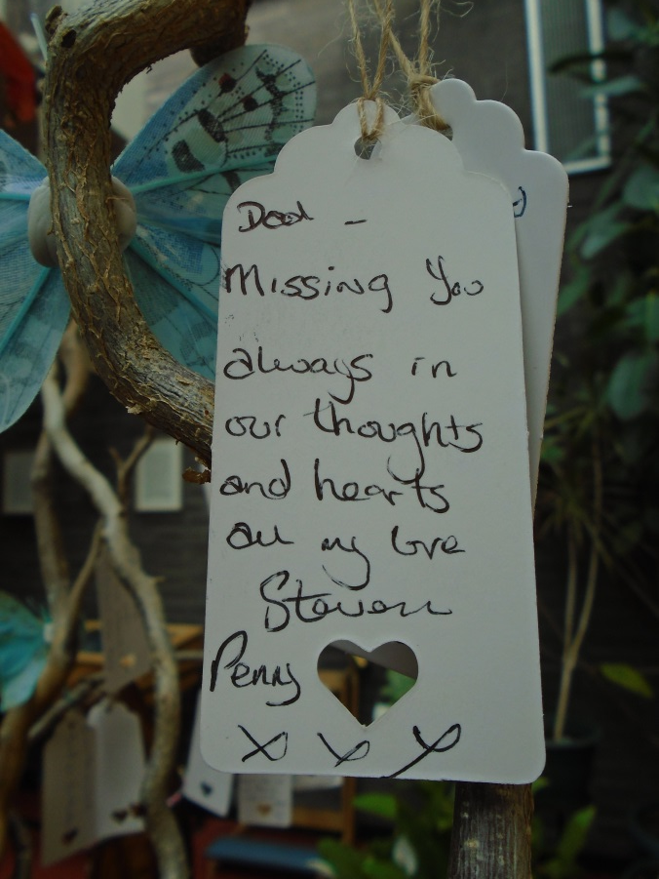
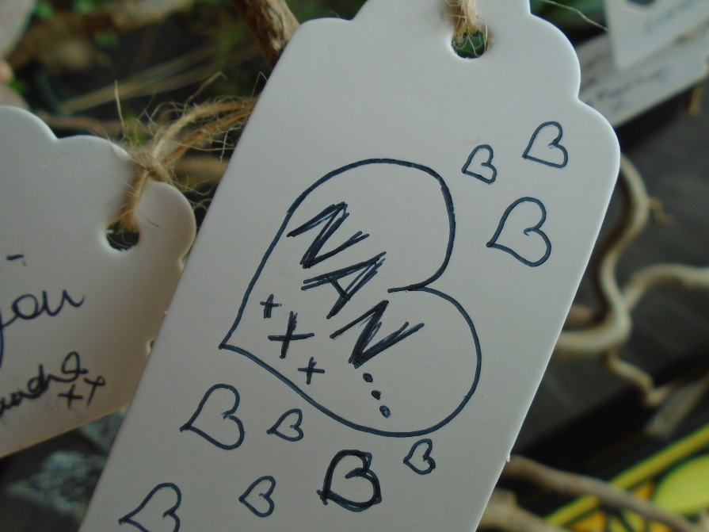
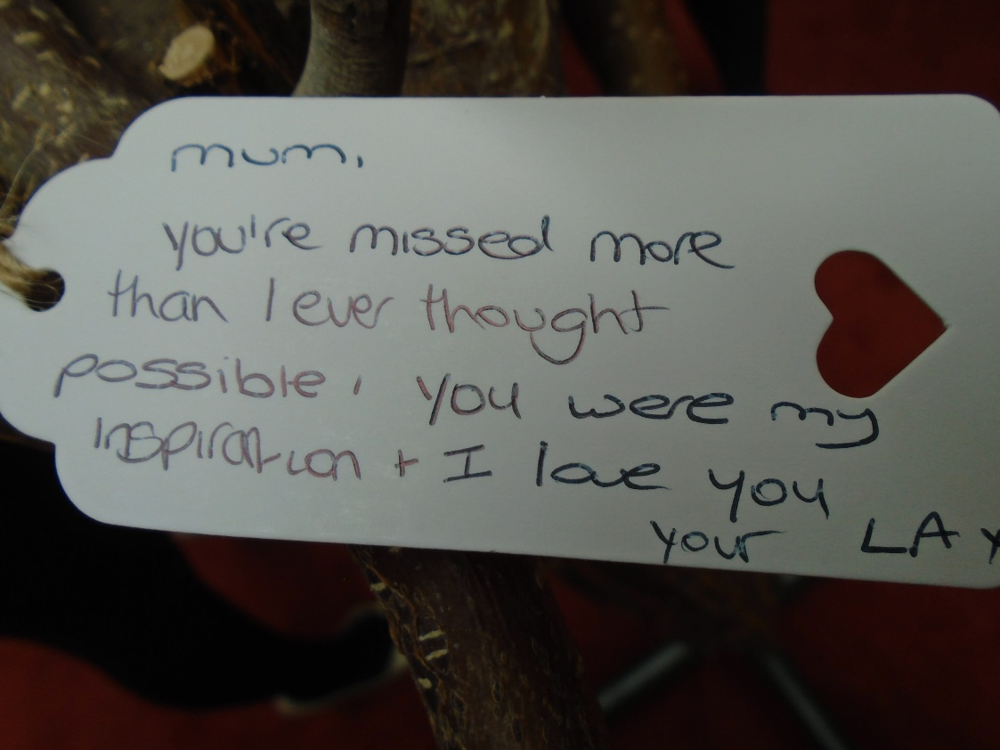
More cards

Slide 21
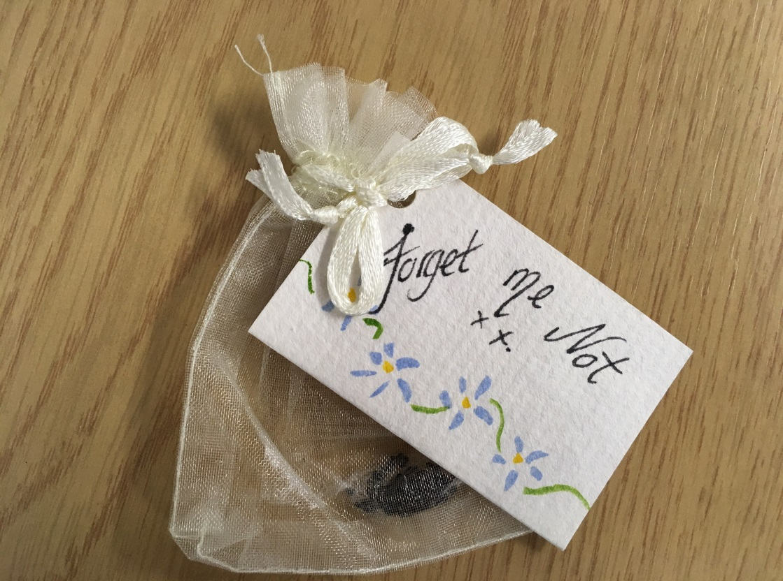
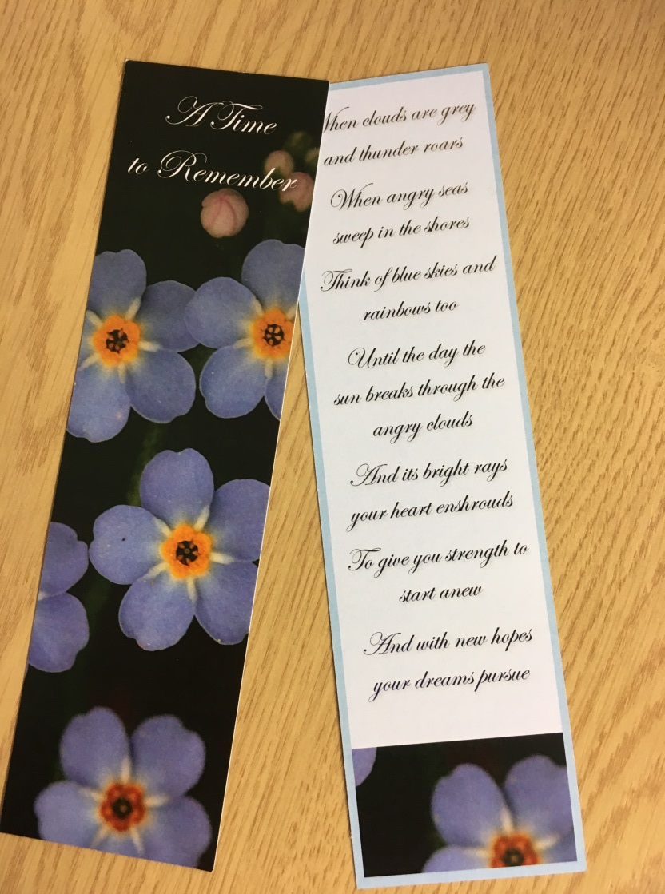
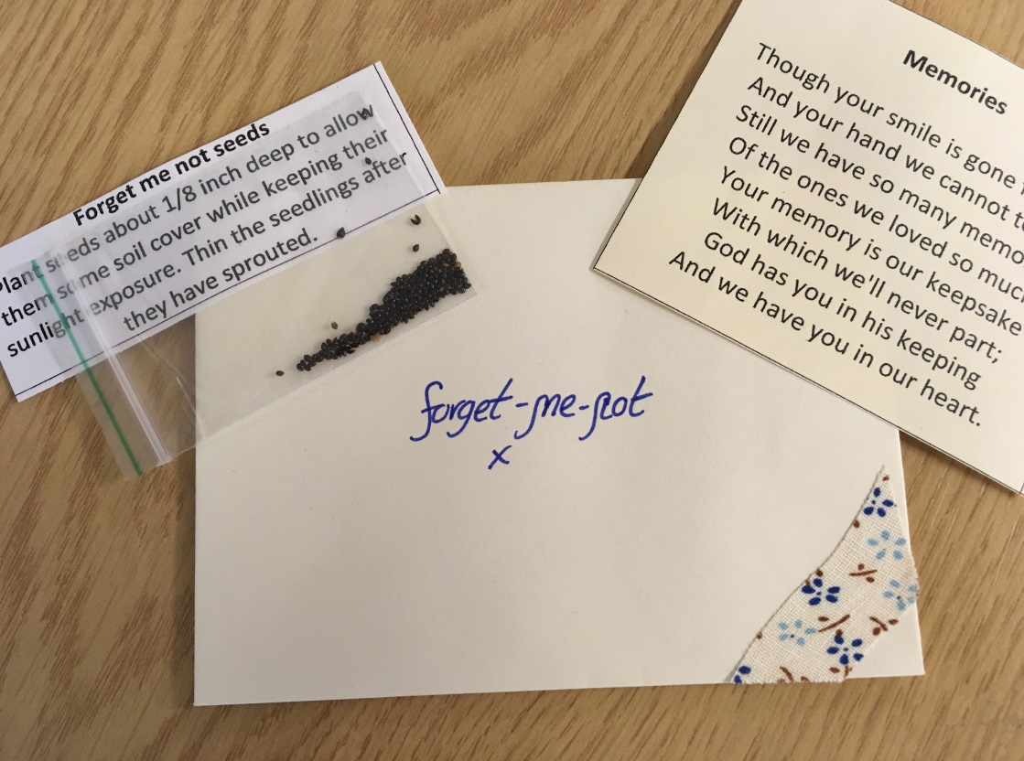

Slide 22
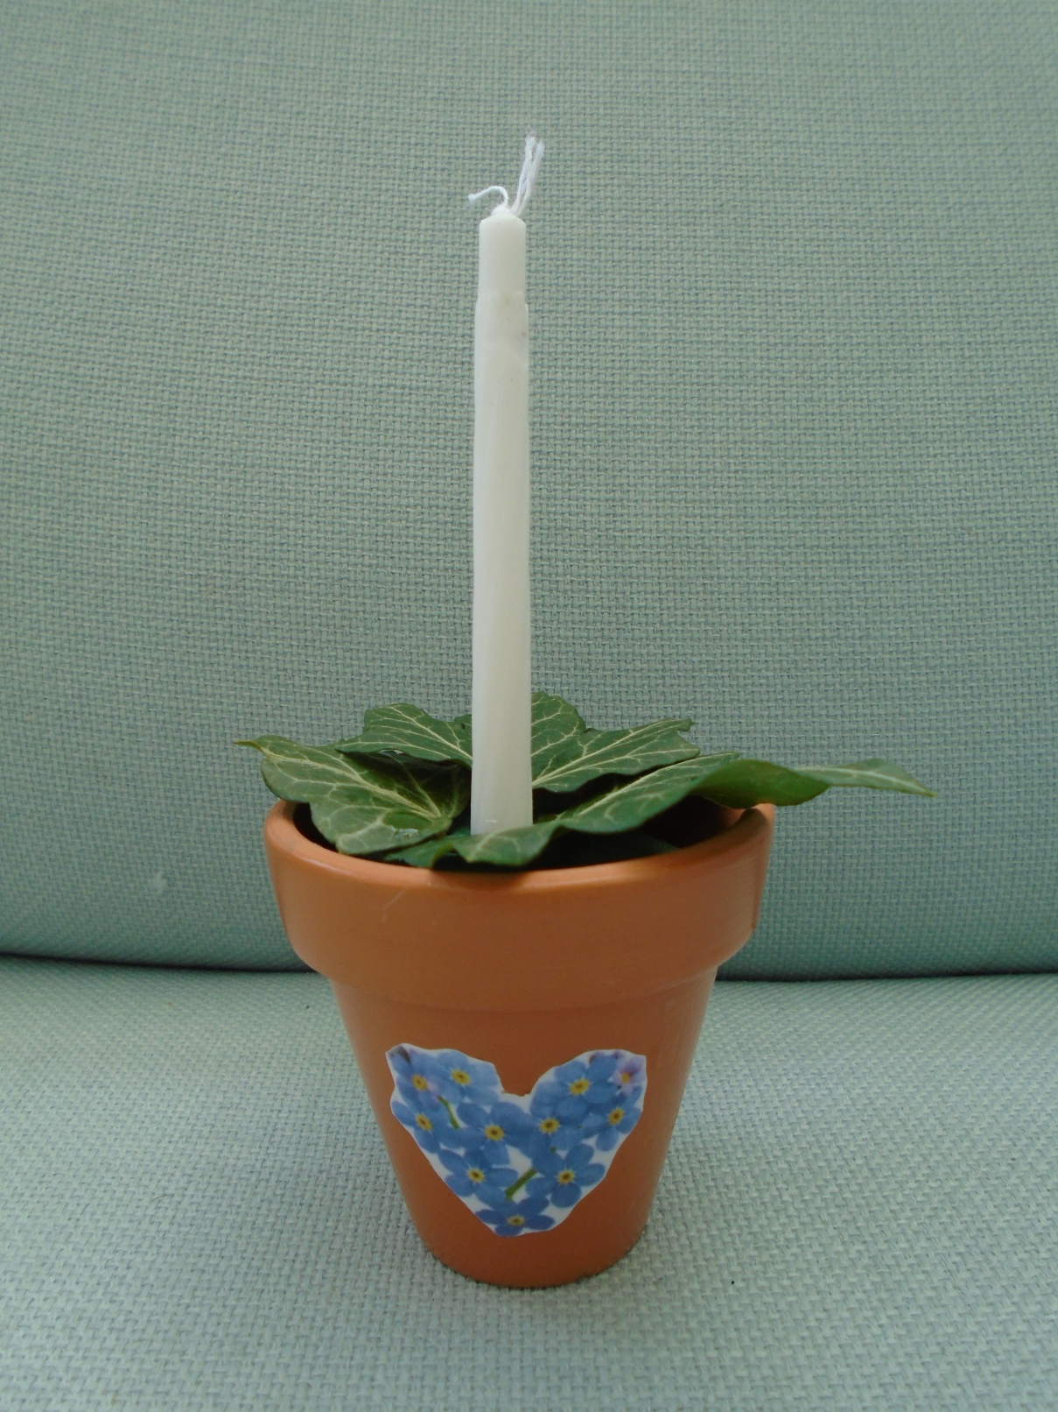
One plant pot

Slide 23
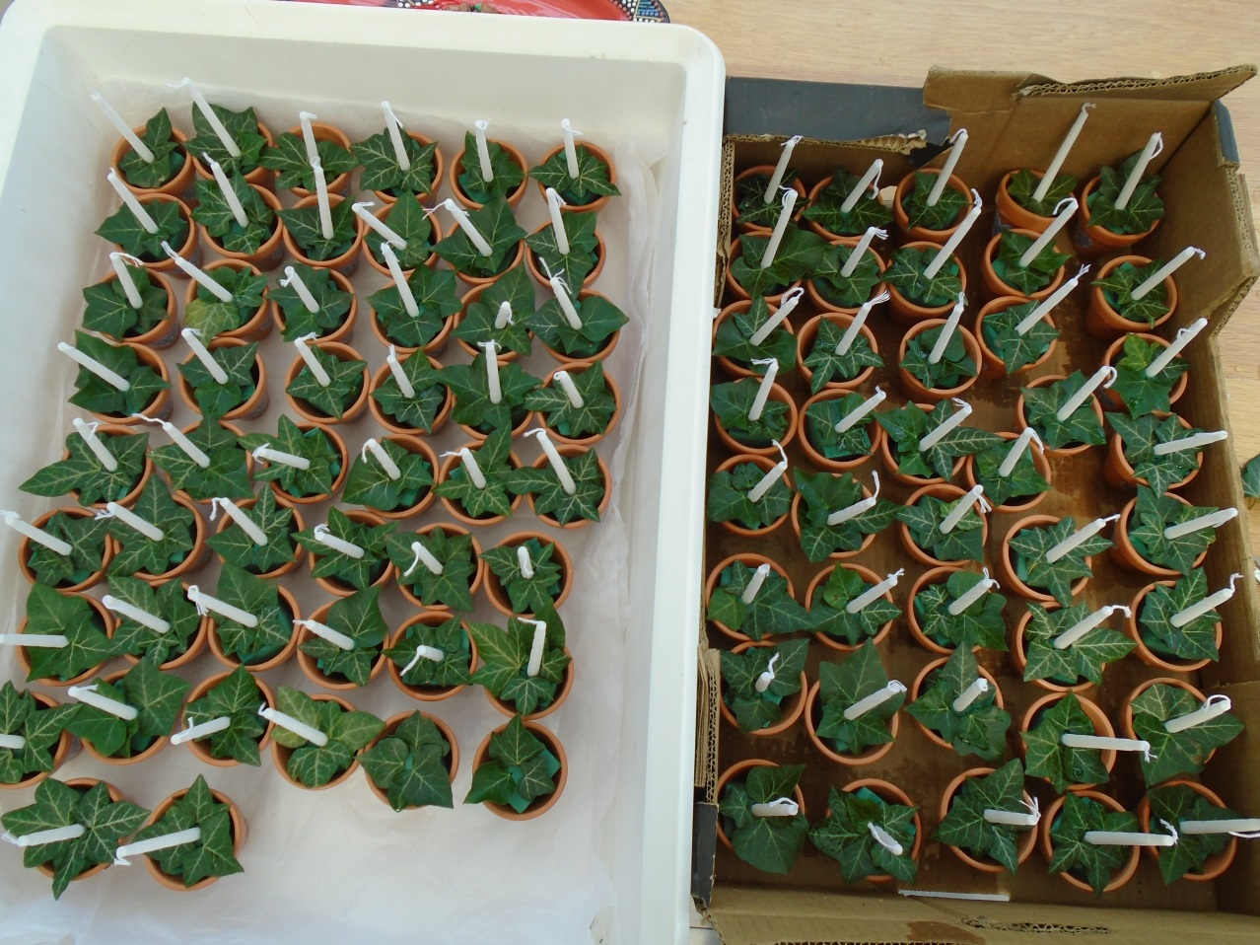
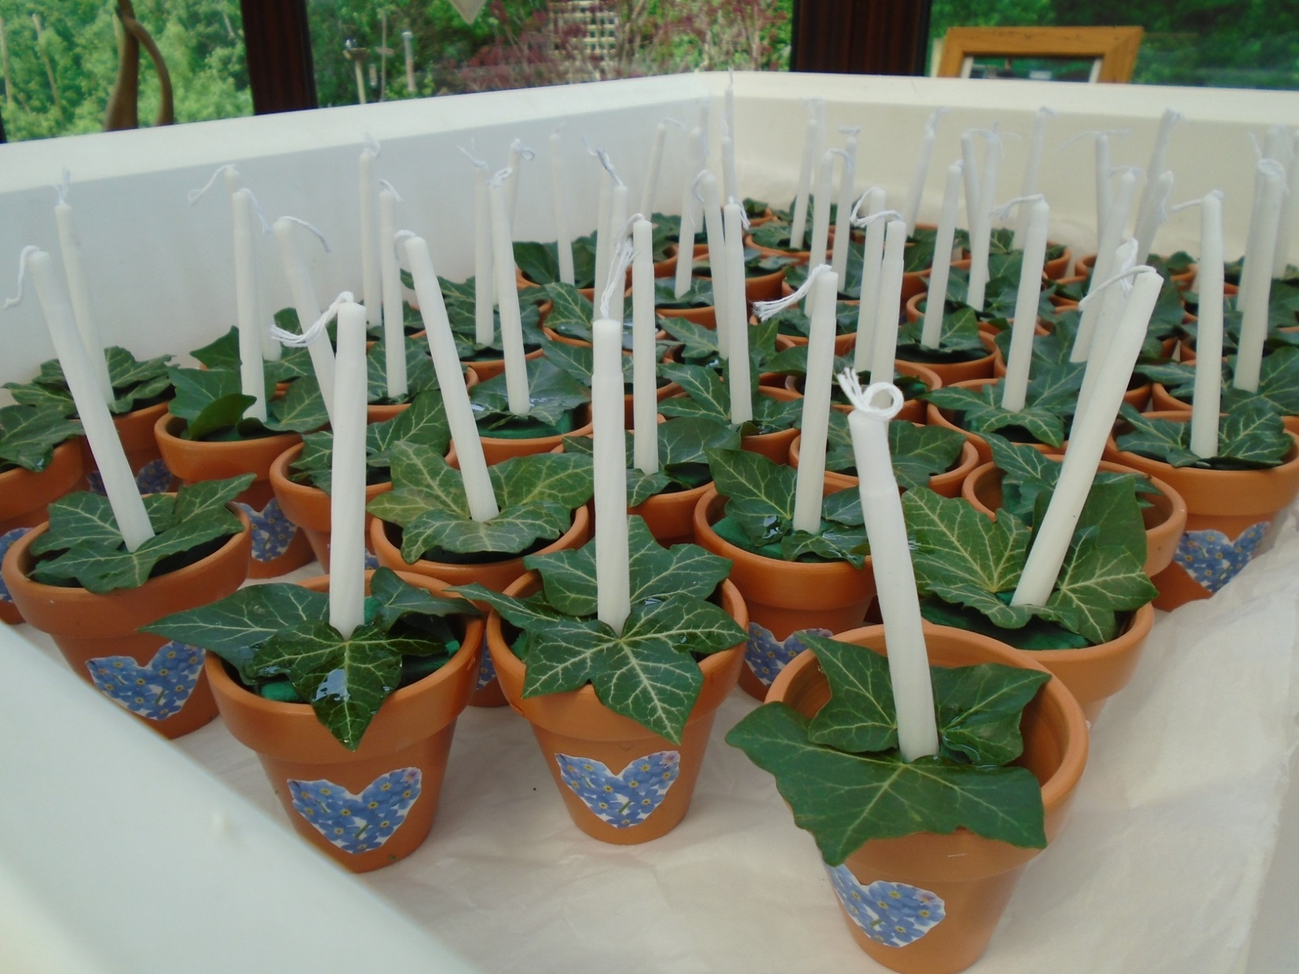
90 more plant pots!

Slide 24
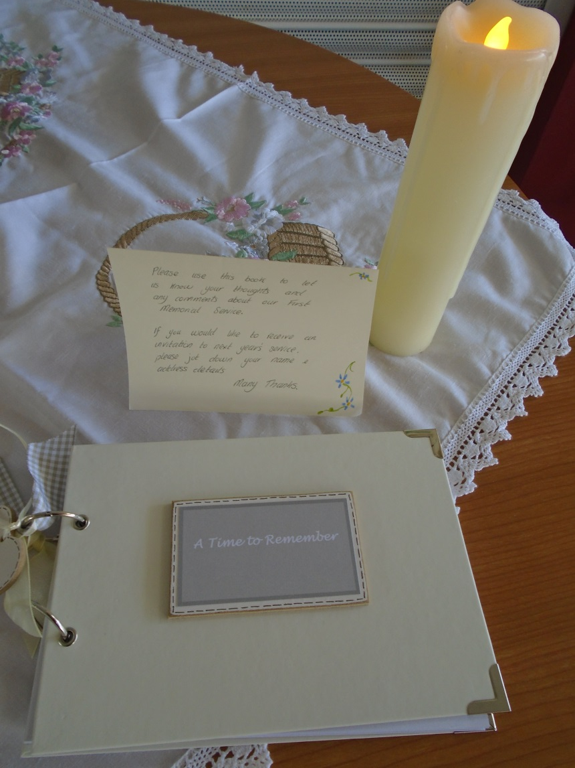
Book of Remembrance

Slide 25
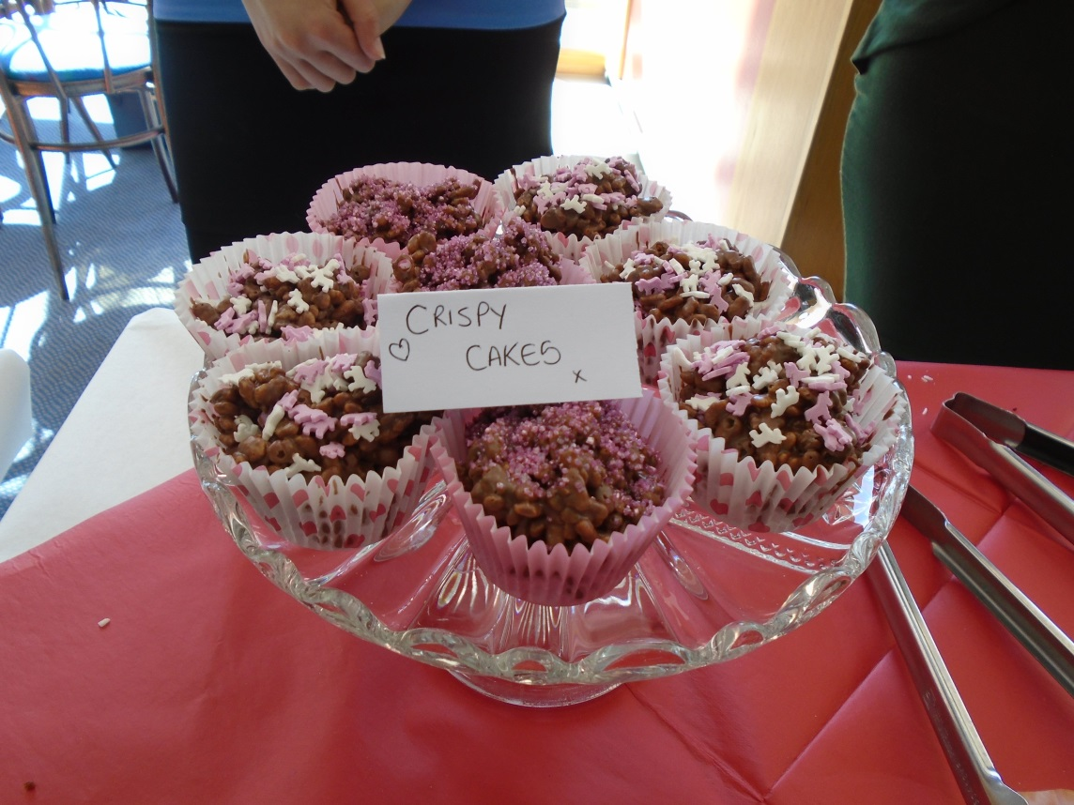
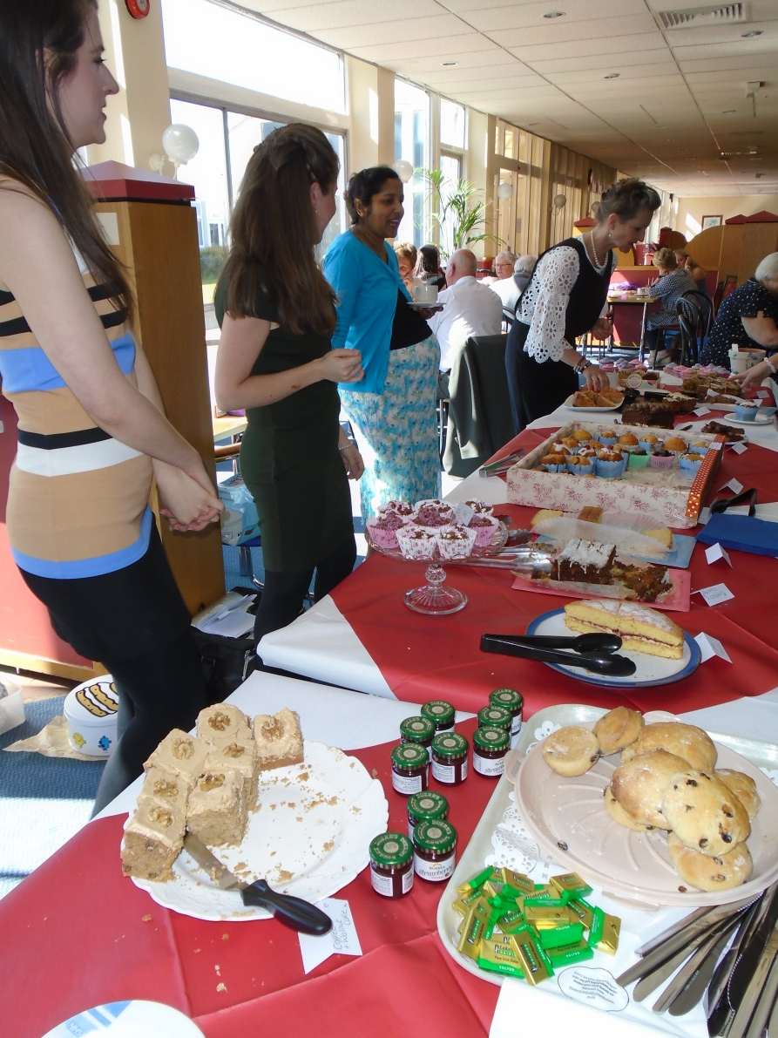
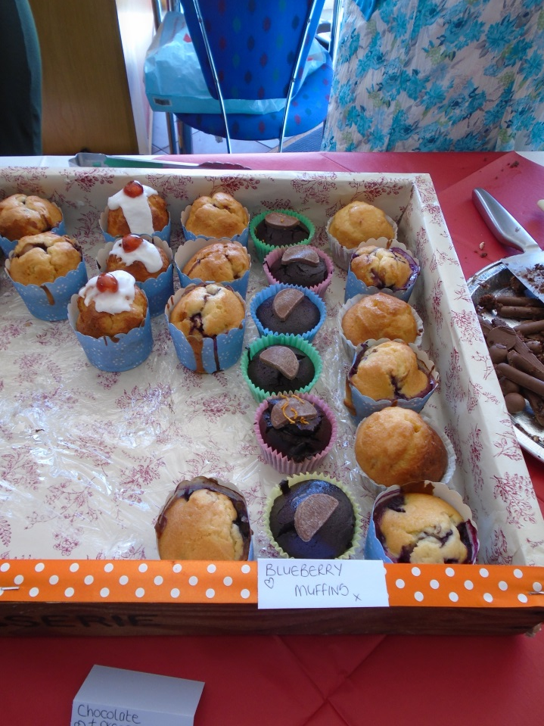
cakes

Slide 26
Why do people come to ‘A time to Remember’
‘I wanted to pay respect to my mum and all the others who have had a similar experience’
‘to hear his name- the thoughtful words that the team had put together. I found it very comforting’
‘lovely music, poems, readings and most of all the welcome I received. Don’t change it. It was so beautiful’
‘to remember my dad. I loved the whole service. I feel it’s “pitch perfect”.’
‘Once again thank you so much for the lovely service on Sunday and the delicious
cakes, God bless you all xxx’

Slide 27
Support groups- Are these a way forward?
Reid et al, 2006 a person’s experience of caring for someone with MND is so diverse it could potentially be a challenge to lead individual support groups and studies have shown that often these groups are not particularly well attended (Reid et al, 2006a).
Reid et al also state there is a potential dependency issue with support groups.

Slide 28
Limitations to the bereavement support
The MND team need to signpost the bereaved to organisations such as CRUSE or to offer contact for counselling in their local hospice. (Honeyman 2015 )
Metzger and Gray in 2008 concluded after studying pre-bereavement support that it has a positive influence in bereavement and allows the bereaved person to experience a lower level of distress but also appreciate and value existing relationships.
Metzger and Gray (2008) affirm that families who accept the reality of the impending death may suffer less distress in bereavement and endorse this by adding that poor preparation may be related to complicated grief.

Slide 29
One final quote
‘It is hoped that people will have sufficient support to feel that they have not been forgotten once the patient had died and appreciate the small gestures of compassion as they enter and journey through their bereavement’ , (Whitehead et al., 2011)

Slide 30
Acknowledgements
Please can I thank all the MND team for supporting this project
Pauline Callagher
Julie Sala
Rebecca Hesketh
Robert Addison-Jones
Professor Chhetri
Rebecca Smith
Joyce Gardham

Slide 31
My Contact Details
Wendy Bennett
Lancashire Teaching hospitals NHS Trust
Sharoe Green Lane
Fulwood
Preston
PR2 9HT
Wendy.bennett@lthtr.nhs.uk

Slide 32
Thank you for listening
Any questions?

