Slide 1
The Use of Cannabis Extract Spray (Sativex) in ALS/MND
Gill Craig
Specialist Nurse
MND

Slide 2
Outcomes
Understanding Cannabis
Tayside Model
Future

Slide 3
What is Cannabis
Cannabis is a generic term for drugs made from the cannabis plant, an annual dioecious flowering herb indigenous to Central Asia
As a drug usually comes in the form
Dried flower buds - marijuana
Resin - hashish
Various extracts collectively known as hashish oil
Cannabis plants produce a group of chemicals called cannabinoids

Slide 4
Cannabinoids
One of a class of diverse chemical compounds that act on cannabinoid receptors in cells that alter neurotransmitter release in the brain
Endocannabinoids – produced naturally in the body
Phytocannabinoids – found in cannabis and some other plants
Synthetic cannabinoids – manufactured artificially

Slide 5
Action of Cannabinoids
Cannabinoid Receptors
Located throughout the body, are part of the endocannabinoid system (ECS) which is involved in a variety of physiological processes
ECS is one of the body’s largest neurotransmitter networks working to achieve homeostasis, and is a crucial physiological system to keep healthy

Slide 6
Endocannabinoids
Endocannabinoids are produced naturally in the body and are involved in a variety of physiological processes including
Motor control
Appetite
Pain and pleasure
Mood
Memory
Sleep

Slide 7
Phytocannabinoids
There are least 113 different cannabinoids isolated from the cannabis plant, exhibiting varied affects
The principal phytocannabinoids with therapeutic potential
Delta-9-tetrahydrocannabinol (THC)
Primary psychoactive compound
Cannabidiol (CBD)
Another major constituent of the plant

Slide 8
Synthetic cannabinoids
Manufactured artificially
Sativex (Nabiximols)
This is a whole plant extract of cannabis blended from different strains to contain a 1:1 ratio of THC:CBD
Bedrocan
Bedrocan is an exclusive contractor to the Netherlands government for the production of medicinal cannabis
It produces a raw herb of cannabis products with varying ratios of THC:CBD

Slide 9
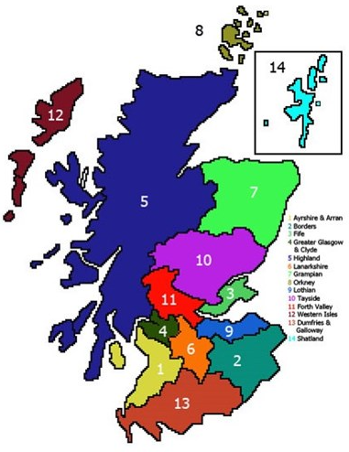
NHS Scotland
Consists of 14 health boards
Population of 5,424,800
Operates across an area of 30,981 square miles
There are 400 patients living with MND in Scotland

Slide 10
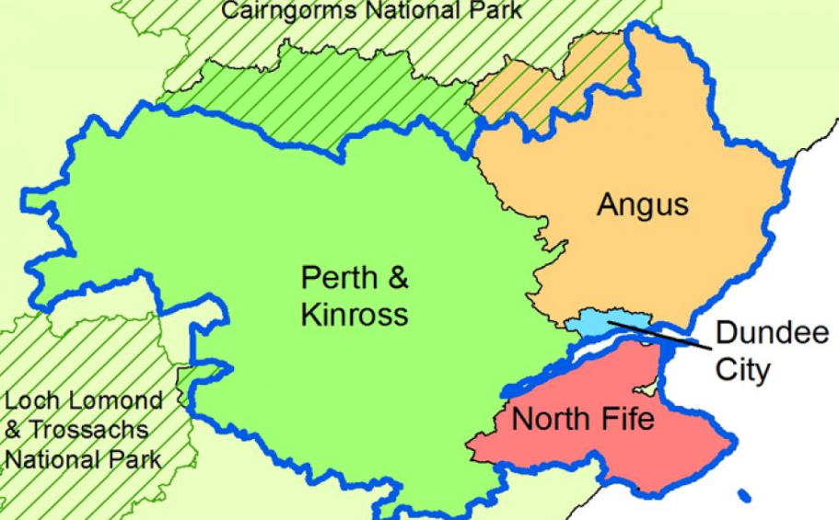
NHS Tayside
NHS Tayside is one of 14 health boards
Operates across 4 boundaries within an area of 3000 square miles – Dundee City, Angus, NE Fife and Perth & Kinross
Combined population of 416,090
Tayside has 57 patients living with MND

Slide 11
NHS Tayside Team
Based in Ninewells Hospital & Medical School, Dundee – 1 of 5 national centres in Scotland
Lead Consultant Neurologist MND
5 x Consultant Neurologists
2 x Specialist Nurses MND (Full-time)
Myriad of multi-disciplinary professionals across 4 localities

Slide 12
Background
Patient developed uncontrolled spasticity
Complex and complicated symptom burden
Pain
Stiff limbs
Involuntary movements
Difficulty moving
Painful spasms

Slide 13
Background
Developed Bulbar Spasticity
Sudden spasms in laryngeal, pharyngeal or neck muscles
Can cause temporary difficulties in breathing, speaking and swallowing
Common triggers, speaking, food ingestion, yawning, neck movement
Particularly alarming and distressing experience with panic, anxiety and fear of dying

Slide 14
Background
Followed NICE Guideline (NG42) MND
5 MONTHS
Pain – simple analgesia +/- NSAID
Muscle stiffness – Baclofen, Tizanidine, Dantrolene, Gabapentin
Cramps – Quinine, Baclofen, Tizanidine, Dantrolene, Gabapentin
Then consider referral to specialist service for treatment review

Slide 15
Background
The impact on ability to maintain Quality of Life
Physical, psychological, emotional pain
Despair
Depression
Frustration
Anxiety
Hopelessness
Anger
Sleep deprivation

Slide 16
Solution
Cannabis
One of the 50 fundamental herbs of traditional Chinese medicine
Useful in treating appetite loss, depression, pain, muscular spasticity, excess saliva, weakness
Emerging evidence (Carter & Rosen 2001!!!) suggested Cannabis has strong antioxidant and neuroprotective benefits, which may prolong cell survival

Slide 17
Issues
Not licenced in UK for MND
Anecdotal evidence
Classification of Cannabis
Public/Professional perception
NICE – do not recommend use
Cost

Slide 18
Plan
Approached Specialist Service
Patient reviewed and assessed OPC
Ensure all treatment options tried as recommended by NICE Guideline 42
4 MONTHS
Application to NHS Tayside for Independent Patient Treatment Request (IPTR)
Admitted to Specialist Unit for initiation and titration of Sativex
Discharge home after initial 5 day initiation with 4 week programme
Review patient’s response after 4 weeks

Slide 19
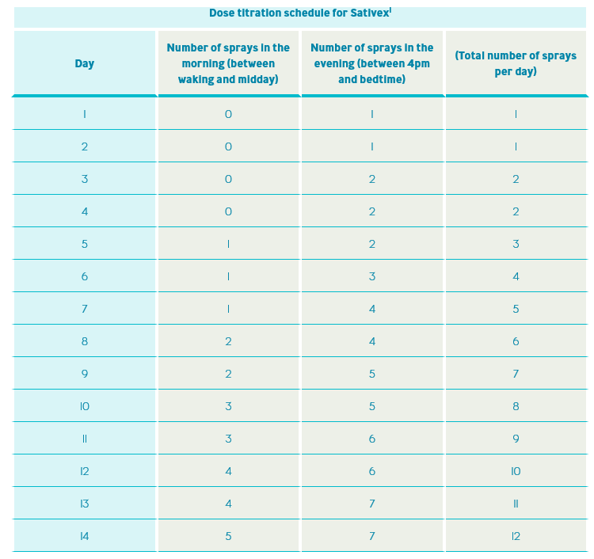
Titration Guidelines

Slide 20
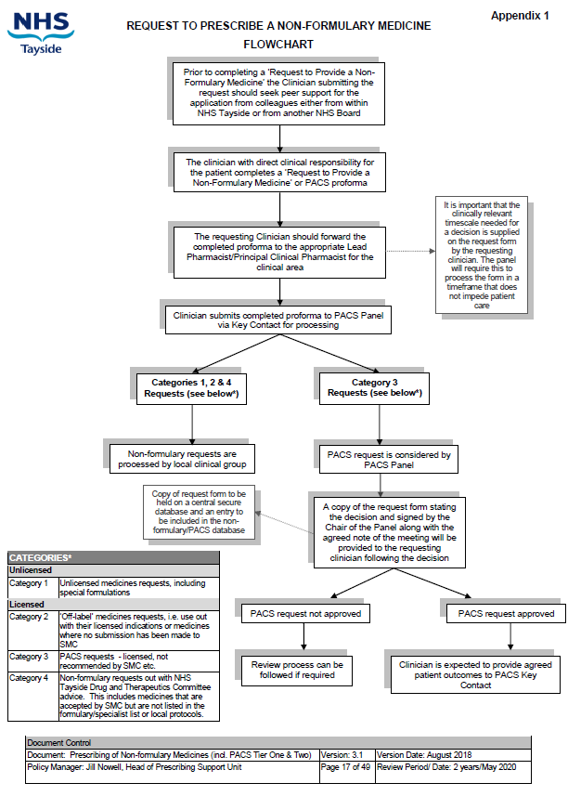
Individual Patient Treatment Request

Slide 21
Patient Experience
Cramping decreased
Muscle spasms decreased
Pain disappeared
Sleep improved
Appetite improved
Anxiety decreased
Abilities day to day living improved
Was able to discontinue all pharmaceutical medication

Slide 22
Patient Story
We now have had 7 patients across Tayside on Sativex.
….honestly, it’s just like night and day since I started this… you know I have come off all my medication…. all their awful side effects. Feel I wasted all that precious time…..
…for the first time in years I was able to join my family in the swimming pool on holiday. I cannot describe that feeling….
…this is my lifeline. It allows me to get up in the morning

Slide 23
Hopes for the Future
2 varieties of Cannabis plants
Indica – known for producing greater feelings of relaxation, helpful in treating anxiety, pain, muscular spasms, seizures, headaches and sleep disturbances
Sativa – known to be more energising, therefore better suited for daytime use. Fosters feelings of creativity, focus, wellbeing and fighting depression.

Slide 24
Hopes for the Future
A licenced hybrid that primarily contains indica while still offering some benefits of sativa would be an ideal product for ALS/MND
Address attitudes and behaviours
Side effects and risks of medicinal cannabis are very well documented in the literature much of which is focussed on identifying harms of recreational use.
The risks are extremely low in a therapeutic context compared with pharmacological medicines

Slide 25
Finally
Cannabis has been used safely for thousands of years. There are no documented cases of death from cannabis side effects
In any case
….what possible side effects could cannabis and its derivate have that would make creeping paralysis and premature death preferable?

Slide 26
Update
1st November 2018 the UK Government announced……
Medical products derived from cannabis will be available on prescription from 1 November 2018, UK home secretary Sajid Javid has announced.
In a written ministerial statement, Javid confirmed that the Misuse of Drugs (Amendments) (Cannabis and Licence Fees) (England, Wales and Scotland) Regulations 2018 will “reschedule cannabis-based products for medicinal use”.
This means that patients will be able to receive cannabis-based medicine on prescription from 1 November 2018. The new law does not place limits on the type of conditions that cannabis may be prescribed for.

Slide 27
However…..
The new Scottish Government Guidance does not allow Sativex to be prescribed differently to current practice. The new guidance only concerns unlicensed cannabis preparations, whereas Sativex is licenced but not SMC approved…….

Slide 28
Gill Craig
Specialist Nurse MND
Department of Neurology
South Block Level 6
Ninewells Hospital & Medical School
Dundee
DD1 9SY
gillian.craig3@nhs.net
01382 425726/07976648176

