Slide 1
Helpline
A Window to Wider Support
Adele O’Toole
MND Connect Adviser

Slide 2
Background
Paid members of staff were recruited
1999
Helpline Standard accreditation
awarded
2015
Reaccredited
2018
1994
A pilot introduced
2007 Rebranded to MND Connect
2016 Freephone number launched
2018 Language line

Slide 3
MND Connect Advisers
The team consists of:
Daytime
5 paid advisers
1 volunteer
Evening
16 helpline volunteers

Slide 4
The helplines aim
Our goal is to provide emotional support as well as reliable and accurate practical information regarding all aspects of motor neurone disease (MND)

Slide 5
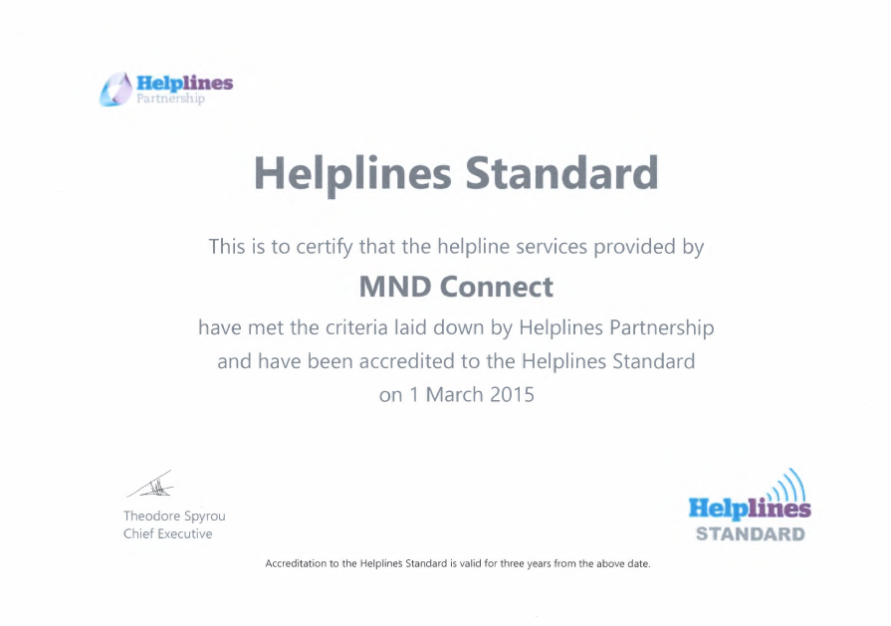
Quality Assurance
Helplines Partnership accreditation Standard was initially awarded in 2015
Re-accredited in 2018
Giving our callers the assurance that they will receive accurate, timely, reliable information and support
“The commitment to delivering an effective, high-quality service was strongly evident” (Helpline Standards Assessor)

Slide 6
People living with MND
Family members
Health and Social Care Professionals
Who we provide information and support to
MND Association Staff
Volunteers
Friends
People concerned they may have MND
Carers

Slide 7
Statistics
*January – July 2018
Notes:
In 2017 MND Connect responded to 8400 requests.

Slide 8
What the service does
Confidential service
Open, honest and difficult conversations
Signposting to internal and external services
Accurate and reliable information on all aspects of MND

Slide 9
Support for health and social care professionals
The wide range of support offered to health professionals
Increase knowledge of MND
Compliments the work of HSCPs
Emotional support
Provide information on funding and equipment loan
Signpost to local support and advice
MND Connect support enables HSCPs to better support their patients

Slide 10
Feedback
“As a professional nurse, it is very reassuring that I can ask for help and information, as motor neurone disease is not common. I need to be sure I am doing everything in my power to offer the best care for my client” Anon
Our impact 2017
“You went the extra mile with your information and assistance” Anon 2018

Slide 11
Recent Developments
Always striving to be the best possible service
Online forum thread
Language line
Caller ID pop up (Xarios)
Measuring impact of service

Slide 12
Future Developments
Over the next few years we hope to launch
Webchat
Text to speak
Call queuing
Growing an information bank of organisations who can provide further support for people affected by MND

Slide 13
Take home messages
Know that the helpline is there to support you in England, Wales and Northern Ireland
Knowledge that working in collaboration with the helpline can help you to support people living with MND
Where possible encourage similar developments in your regions

Slide 14
Contact Us
Monday to Friday
9am - 5pm and 7pm - 10:30pm
Calls to this helpline are free from landlines and mobile phones
within the UK and do not appear on itemised bills

