Slide 1


Challenges of assessment and management of cough augmentation in MND
Charlotte Massey (Highly Specialist Physiotherapist)
Charlotte.massey@nhs.net
@Char_Massey
The National Hospital for Neurology and Neurosurgery, Queen Square, London, WC1N 3BG

Slide 2

Disclosures
No disclosures
With thanks to MNDA North London for funding conference attendance

Slide 3
Introduction/Background
What do we know about cough in MND currently?
  Reduced lung volumes and weak abdominal muscles result in an inadequate cough
  Bulbar impairment prevents glottic closure and pharyngeal contraction (Toussaint et al 2009)
Recent evidence and guidelines emerging in management of cough in MND:
  ‘Offer cough augmentation techniques […] to people with MND who cannot cough effectively’ (NICE, 2016)
  ‘The application of positive inspiratory pressures should be tailored to the individual’ (Anderson et al 2018)

Slide 4
BUT!
There are many unanswered questions…
When should patients be offered cough augmentation?
How do we decide what cough augmentation to offer?
What are the optimum settings and frequency of cough augmentation?
What is the best way to assess for cough augmentation?
Are there any risks of cough augmentation?

Slide 5

MND Service at NHNN
Over 200 patients on the caseload
Large geographical area
Clinical areas:
  MND clinics
  Respiratory clinics
  Neurology wards
  NMCCC

Slide 6
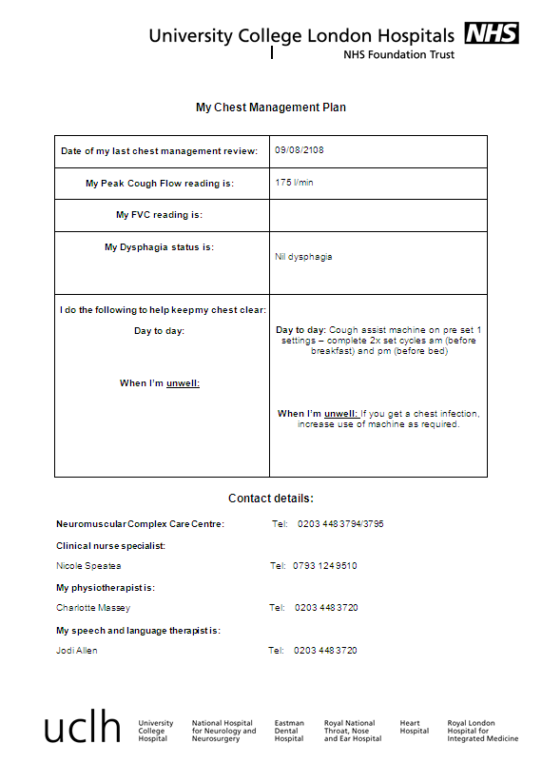
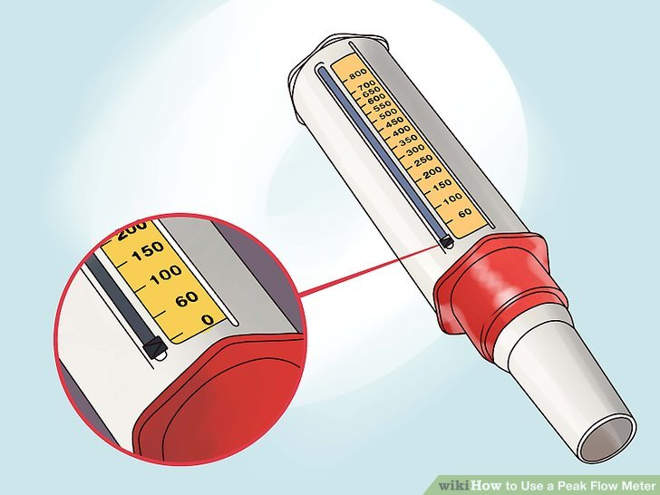
Current Process
Assessment
PCF <270 l/min
PCF >270 l/min
Assessment by PT/SLT
Issued with breath stacking exercises or ACBT and respiratory information given.
Patients monitored via clinic
Individualised chest management plan issued

Slide 7
Data Collection
Data collected on 52 patients under MND service at NHNN
  December 2017 – October 2018
All patients assessed by PT/SLT
Assessments completed:
  Peak cough flow (PCF)
  Forced Vital Capacity (FVC)
  Mobility status
  MND diagnosis
  Number of chest infections in 6 months
  Nasoendoscope assessment was completed on patients if indicated
Notes:
Explain difference in numbers n=16 Dec to March which is in abstract

Slide 8
MND Diagnosis
Notes:
⁃ ALS = 25 (48.1 %)
⁃ Bulbar onset = 16 (30.7%)
⁃ FTD MND = 2 (3.8%)
⁃ PLS = 3 (5.9%)
⁃ Respiratory onset = 1 (1.9%)
⁃ LMN variant = 1 (1.9%)
⁃ Not specified = 4 (7.7%)

Slide 9
Peak Cough Flow

Slide 10
PCF under 270
Diagnosis
Mobility Status

Slide 11
Cough Augmentation
19 successfully setup with cough augmentation
18 unsuccessful with cough augmentation
14 MI:E
5 LVR bag
Notes:
What makes set up sucessful

Slide 12
Reasons for failed cough augmentation initiation
⁃ Uncontrolled sialorrhoea
⁃ Bulbar collapse
⁃ Cognitive impairment
- Breathlessness
⁃ Unmanaged dysphagia
Notes:
Re do table -1 in cognitive and 1 in bulbar collapse

Slide 13
Question
Can we predict which patients will have successful set up of cough augmentation using any of the following predictors?
FVC
Mobility status
No of chest infections
Type of MND
PCF

Slide 14
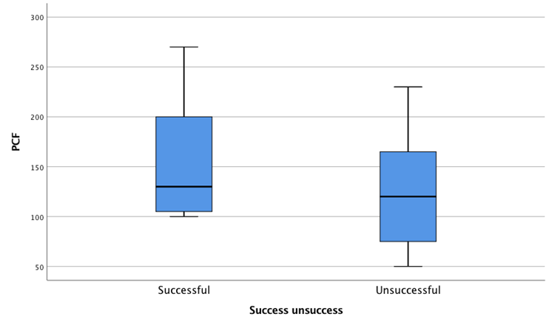
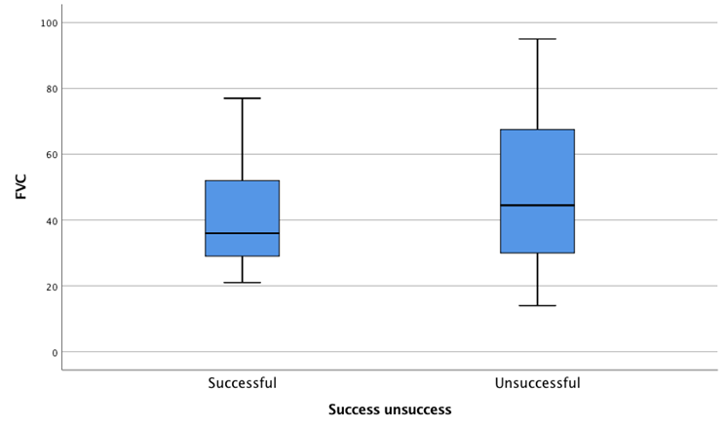
Results
Notes:
Range is higher in successful group
Line is median
Successful higher values and range of 170
Unsuccessful is generally lower values with a slightly wider range 180
No significant difference between the groups using mann whitney test

Slide 15
Results Overview
p < 0.05

Slide 16
Conclusion
There was only a 50% success rate for setting up traditional cough augmentation with patients with MND
There is NO significant predictor of successful set up vs unsuccessful set up in a general cough assessment
There are numerous factors that have to be considered when compiling a respiratory management plan for patients with MND

Slide 17
Recommendations to field
At point of referral physicians and therapists need to be aware of possible barriers to cough augmentation (eg cognition)
Identify and modify risk factors (eg sialorrhoea, dysphagia)
We recommend a joint assessment by PT and SLT to identify and manage risk/benefit of cough augmentation and provide MDT chest management

Slide 18
References
Chatwin M, Ross E, Hart N, Nickol AH, Polkey MI, Simonds AK (2003) Cough augmentation with mechanical insufflation/exsufflation in patients with neuromuscular weakness. Eur Respir J 2003; 21: 502–508
Toussaint M, Boitano L, Gathot V, Steens M, Soudon P (2009) Limits of effective cough-augmentation techniques in patients with neuromuscular disease. Respiratory care; 54 (3): 359-366
Park JH, Kang SW, Lee SC, Choi WA, Kim DH (2010) How respiratory muscle strength correlates with cough capacity in patients with respiratory muscle weakness. Yonsei Med Journal; 51 (3): 392- 397
Rafiq M, Bradburn M, Proctor A, Billings C, Bianchi S, McDermott C (2015) A preliminary randomised trial of the insufflator-exsufflator vs breath stacking technique in patients with Amyotrophic lateral sclerosis. J ALS & Frontotemporal degeneration; 16: 7-8
Sancho J, Martinez d, Bures F, Diaz JL, Ponz A, Severa E (2018) Bulbar impairment score and survival of stable amyotrophic lateral sclerosis patients after noninvasive ventilation initiation . ERJ 16; 4(2)
Anderson T, Sandnes A, Brekka A, Hilland M, Clemm H, Fondenes O, Tysnes O, Heimdal JH, Vollsaeter M and Roksund O (2018) Laryngeal response patterns influence the efficacy of mechanical assisted cough in amyotrophic lateral sclerosis. Thorax online.
NICE Guidelines: Motor Neurone Disease: Assessment and management (2016) https://www.nice.org.uk/guidance/ng42

Slide 19

Thank you for listening
Any questions?

Slide 20
Contact Information
Charlotte Massey (Highly Specialist Physiotherapist)
Charlotte.massey@nhs.net
@Char_Massey
The National Hospital for Neurology and Neurosurgery,
Queen Square,
London
WC1N 3BG

