Slide 1


Non-Invasive Ventilation from diagnosis to End of Life: hospice staff training in discussions, decisions and practical management
Sr Jane Martin – Advanced Nurse Specialist
and Ally Lycett – Senior Physiotherapist
Specialist Palliative Care service, Macmillan Unit, Dorset, UK.
Notes:
Hello my name is Jane Martin, I’m an Advanced Nurse Specialist with the Palliative Care Service based at The Macmillan Unit Hospice in Christchurch, Dorset in the UK.
The palliative care service is jointly funded by Macmillan Caring Locally – which is a Dorset based charity, and the Royal Bournemouth and Christchurch Hospitals NHS Trust.
Ally and I have developed some training for our team that we’d like to share with you today.

Slide 2

Notes:
The Specialist Palliative Care service looks after all people living with with MND in East Dorset (in the UK) from diagnosis to the end of life, both in the community and in the hospice.
This is Dorset! I’m biased – but it’s lovely!

Slide 3
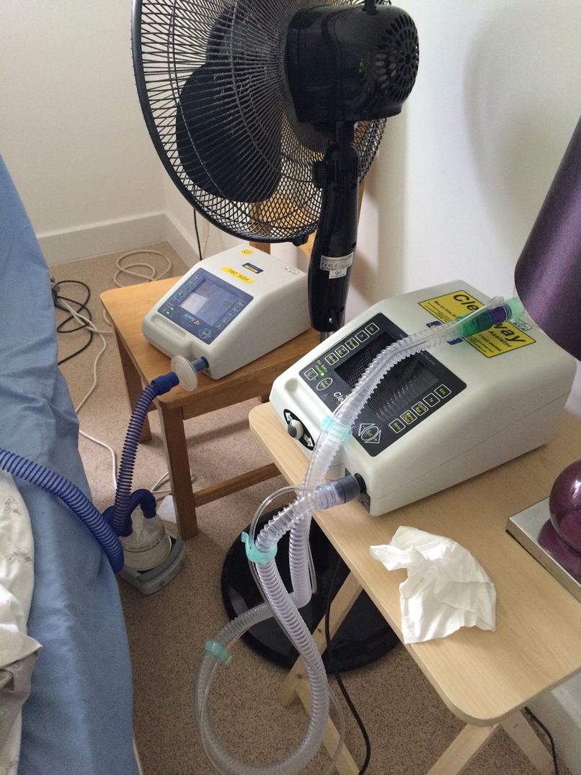
Notes:
As most of you know: Non-invasive ventilation is a symptomatic and life-prolonging treatment that is now widely used in the care of people with MND.
These people experience progressive muscle weakness and wasting, and this can include the muscles of respiration.

Slide 4
Notes:
NIV assists patients’ breathing as their disease progresses - in a similar way to an electric bike helping when you tire from cycling.
Patients can become dependent on NIV as they approach the end of their lives.

Slide 5
Seminal article
Bourke SC,et al
Effects of non-invasive ventilation on survival and quality of life in patients with ALS: a randomised controlled trial.
Lancet Neurology 2006; 5:140-7
Notes:
Bourke published the first large multi-centre Randomised Controlled Trial in 2006 and…

Slide 6
Notes:
..this was a key milestone in MND research. It showed, for patients without swallowing and speech symptoms, NIV increased survival by up to 18 months.
There was also significant improvement in symptoms due to hypercapnia, such as morning headache and wakeful nights for those with or without bulbar symptoms.

Slide 7

Motor Neurone Disease: Non-invasive ventilation
Clinical guideline [CG105]
Published date: July 2010
Notes:
In 2010, NICE published guidance for NIV in people with MND.
With wide implementation of these guidelines, the use of NIV increased.
The Respiratory Centre at Southampton Hospital , which is our nearest specialist NIV service, was rapidly expanding it’s home ventilation program.
From 2010 onwards we saw the impact of this on our service, as people living with MND were increasingly choosing NIV and dependent on this approaching the end of their lives.
Some patients decided to stop using NIV in our hospice; this was one of the triggers for this project.

Slide 8
Identifying the need for training for service improvement:
Staff feedback
Notes:
Staff feedback and reflections following NIV withdrawal showed that some had found this distressing, and there was lack of clarity regarding the Law and Ethics.
Staff said “ is this assisted suicide”, and ‘I felt like I killed her when I took the mask off’. In addition there was a lack of competence in practical management or the equipment.

Slide 9
Evidence
Baxter – (2013) unexpected terminal phase, advocated early ACP
Faull (2014) emphasised early decision making, risk of cognitive changes
Notes:
Looking at some of the evidence: Baxter (2013) published qualitative research into the effects of NIV withdrawal on families and Health Care professionals: suggesting that the terminal phase of MND could be unexpectedly rapid. Early Advance Care Planning was advocated, acknowledging, however, that this can be difficult.
Deciding about NIV is just one of many difficult and complex Advance Care Planning decisions the person living with MND has to make.
Indeed Faull, in 2014, emphasised early decision making, due to the risk of the onset of cognitive changes limiting future discussions.

Slide 10
Evidence
Harris (2015) – important to listen to person early before communication becomes difficult
Levi (2017) – suboptimal decision making during a crisis
Notes:
Additionally: Harris in 2015 suggested that Allied Health Professionals.. ‘need to listen to a person’s existential concerns for life and death early in their
illness trajectory and while they can still communicate’.
Recent evidence supports this : Levi et al, in 2017 ,suggests that when people living with MND fail to communicate their wishes for future medical treatment, the consequence is often suboptimal decision making during a crisis.

Slide 11

Identifying the training need for service quality improvement:
Audit of patients
on Macmillan Unit
Lack of confidence
Complexity
Unfamiliarity
Notes:
A audit of our hospice found that from June 2014-Sept 2015 - there were 303 days with a person with MND in the hospice and of those 59 days where a person was using NIV. This helped quantify the need for ward based training.
Hospice staff, lacked confidence in when to start discussions, both around the appropriateness of commencing NIV or not, and the future possibility of withdrawal.
There was a perceived complexity of the decision making; some felt that this was a medical responsibility only. This was despite an advanced level of communication skills around Advance Care Planning and EoLC that is inherent within a Hospice MDT.
Simonds, in 2007, found that ‘some hospices are not familiar with the use of NIV’. And indeed our hospice staff lacked experience with practical management of the equipment.

Slide 12


Discussions
Notes:
Initially we reviewed the NICE guidelines, and we drew out these main issues:
Firstly discussion.
There were 4 suggested points in the patient pathway for discussions regarding NIV –
soon after diagnosis
when monitoring respiratory function or
when it deteriorates
Lastly - if the patient asks for information

Slide 13
Respiratory assessment
Patient selection
Staff competencies
Equipment and care
Withdrawal of NIV
Notes:
Assessment, selection and competencies:
NICE suggested 3 monthly respiratory screening, and that
“Team members who provide non-invasive ventilation should have appropriate competencies”
Withdrawal:
NICE recommended that discussions regarding withdrawal were initiated while patients were considering NIV, although detail re: the practicalities of withdrawal was limited, and directed to a 'professional with experience'.
This was something we had no experience of as a team specifically for NIV in MND; although withdrawal of treatments is not unusual in the context of Specialist Palliative Care.

Slide 14
Aims - what did we want to achieve?
Early discussions and decisions
Ethical and legal foundation
Notes:
We wanted to design a hospice training programme that would cover the following:
to help staff become confident to discuss NIV from diagnosis and help patients make decisions, screen and refer the right people at the right time
we wanted to educate all palliative care staff regarding relevant ethics and law.

Slide 15
Aims - what did we want to achieve?
Staff competent and confident practically
Planned ventilation and withdrawal
Support staff
Notes:
to train staff to manage the equipment and interfaces, especially out of hours, and lower the risk of complications, for example due to pressure.
we wanted to educate regarding NIV withdrawal
And, give an opportunity for staff to reflect on difficult cases and ask questions.

Slide 16
Nov 2013 - staff reflection
Notes:
So starting in 2013..
In November we sat down as a Multi-Disciplinary Team to reflect on 5 recent cases of withdrawal of NIV for patients in the hospice.

Slide 17
2014/5 - external training
Notes:
We then attended external training:
In 2014 - 4 hospice staff including ward staff, physios and myself each attended a 2 day British Thoracic Society NIV course and we attended King’s MND Centre study days, which are run in collaboration with St Christopher’s Hospice.
The physios gained spirometry competencies at Bournemouth Hospital Respiratory Physiology and my colleague, physio Ally Lycett, completed competency training in NIV at Southampton Respiratory Centre on an honorary contract.

Slide 18
2015 - literature searches/advice
Notes:
In 2015 We completed further literature searches on respiratory screening.
we also sought advice from our MNDA Regional Care Development Advisor - Louise Rickenbach.

Slide 19
Aims: What did we want to achieve?
Competencies
Training
Withdrawal Pathway
Notes:
Starting in 2015 - we developed
Local Staff Competencies
A plan for a 3.5 hour training session, which was reviewed by Southampton Respiratory Centre. This was a mix of presentations and practical sessions covering:
respiratory function in MND
The practical management of NIV and
discussions and decision making.
In addition, we presented professional guidance on the law and ethics that support the decisions surrounding both commencing and withdrawing NIV.
We used resources from the BBC Radio 4 programme – “Inside the Ethics Committee”, which addressed the uncertainty and the conflicts that arise in a team when staff have differing ethical understanding and values.
A Macmillan Unit withdrawal pathway was started. We found other hospices nationally were also trying to write similar guidelines.

Slide 20
Aims: What did we want to achieve?
Respiratory Assessment
Dorset Respiratory Care
Pathway
Nursing care plan
Notes:
We designed a respiratory screening tool– for use by hospice physio’s
In collaboration with the Pan Dorset MND Group – we developed a Respiratory Care Pathway – with local consultation from palliative medicine, neurology and respiratory consultants.
NIV was added to the hospice nursing care plan in collaboration with our clinical lead.

Slide 21
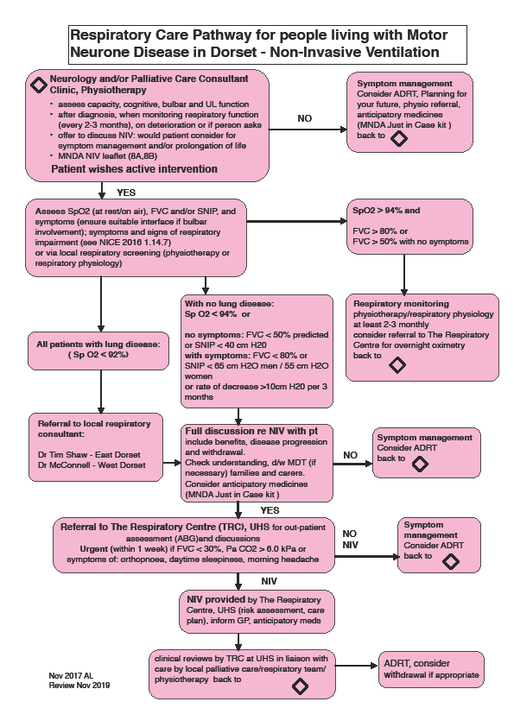
Notes:
This is the Dorset Respiratory Care pathway that we wrote collaboratively, which is on the MNDA and Dorset CCG websites – it’s local use is intended for primary care and non-specialists.
Discussions and ethical decision making are a key part of the pathway.
This was as part of a wider set of Dorset pathways for MND including nutrition, communication and EoLC.

Slide 22

NICE February 2016 Motor Neurone Disease: assessment and management
Withdrawal of assisted ventilation at the Request of a patient with Motor Neurone Disease – guidance for professionals. APM 2015
Notes:
While we were doing this, NICE published updated MND guidelines that incorporated management of NIV.
And the Association of Palliative Medicine published detailed draft guidelines for withdrawal of NIV in MND, which we decided to use and discontinued developing ours.

Slide 23
Training delivered
Sept 2015 - Feb 2018
Feedback collected - asked staff to rate themselves 1 - 4
Notes:
So between Sept 2015- Feb 2018
We delivered 5 x 3.5 hour training afternoons. All specialist palliative care trained staff attended: including ward and community nurses, Consultants, Registrars, medical and therapy staff, Macmillan Day Centre and the discharge co-ordinator.
It was also attended by our MNDA Regional Care Development Advisor and some Dorset physiotherapists
We collected feedback; we asked staff to rate themselves on the following 3 questions, on a scale of 1-4:
Where:
1 - was poor
2 - adequate
3 - good
And 4 was excellent
44 staff completed feedback forms.

Slide 24
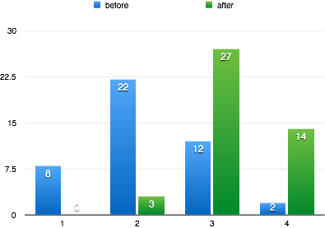
Q1: Please rate your ability to recognise signs + symptoms of respiratory failure in MND
Notes:
You can see here the 1- 4 rating along the horizontal axis:
blue is before training
green is after training,
(PAUSE)
For Q1: this was regarding the recognition of respiratory failure in MND,
93% rated themselves good or excellent after training
This is important as recognising signs and symptoms is a trigger for NIV discussions

Slide 25
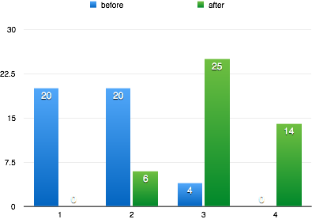
Q2: Please rate your knowledge of the practical use of NIV
Notes:
Secondly, when asked to rate their practical confidence..
88% rated themselves good or excellent after training.
In real terms, the staff are more confident in their skills.

Slide 26
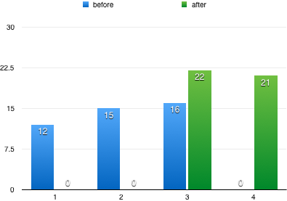
Q3: Please rate your knowledge of the legal and ethical principles of withdrawal of NIV
Notes:
The best results were in the area of legal and ethical frameworks where
97% of staff rated themselves good or excellent after the training.
This has supported confident and competent NIV withdrawal both within the hospice and subsequently in the community.
Which has the added benefit of supporting the primary care team.

Slide 27
Hospice based MDTs can be confident in NIV
discussions, decision making, including withdrawal and practical management, from diagnosis to EoLC.
Staff need training to be confident and competent
Specialist palliative care teams based within
a hospice are ideally placed to deliver this.
Notes:
To summarise:
Hospice based MDT’s can be confident in NIV discussions and decision making, including withdrawal, and practical management, from diagnosis to EoLC.
NICE guidance suggests that a Multi-Disciplinary Team can improve care and extend life for people living with MND.
Staff need training to be confident and competent
Hospice based palliative care MDTs can develop the skills and confidence to manage NIV from diagnosis to end of life
Specialist palliative care teams based within a hospice are ideally placed to deliver this.
Hospice based teams can help the right people select NIV at the right time for the right length of time, recognising that they may wish to discontinue this.
Extending life is not everyone’s priority, and NIV is not right for every person living with MND who fits the criteria.
Specialist Palliative Care is about the whole person, respecting their individual preferences, attitudes, wishes, values, and beliefs, and many of the skills inherent in a hospice team can be used to provide this care.

Slide 28
References
BBC Inside the Ethics Committee (2011). Available at: https://www.bbc.co.uk/programmes/b012r7j
Baxter, S. (2013) ‘The use of NIV at end of life in patients in patients with MND’. Palliative Medicine 27(6) 516-52
Bourke, S.C., Williams, T.L., Bullock, R.E., Gibson, G.J., Shaw, P.J., (2002) ‘Non-invasive ventilation in motor neuron disease: current UK practice'. Amyotrophic Lateral Sclerosis and Other Motor Neuron Disorders ; 3:145-149
Bourke, S.C., Tomlinson, M., Williams, T.L., Bullock, R.E., Shaw, P.J., Gibson, G.J.,(2006) 'Effects of non-invasive ventilation on survival and quality of life in patients with amyotrophic lateral sclerosis: a randomised controlled trial'. Lancet Neurology ; 5:140-7
British Thoracic Society Standards of Care Committee (2002) BTS Guideline: Non-invasive ventilation in acute respiratory failure. Thorax; 57: 192-21
Faull, C., (2015) ‘Withdrawal of assisted ventilation at the Request of a Patient with Motor Neurone Disease’. Association for Palliative Medicine.

Slide 29
References
Faull, C., et al (2014). ‘Issues for Palliative Medicine doctors surrounding the withdrawal of NIV at the request of a patient with MND: a scoping study’. BMJ supportive and Palliative Care 4:43-39
Harris, D.A., (2016). ‘Existential concerns for people with MND: who is listening to their needs, priorities and preferences? BJOT 79 (6) 391-393
Levi., et al (2017) Advance Care Planning for patients with ALS. ALS fronto-temporal Degen. August 18 (5-6): 388-396
NICE (2010) Motor Neurone Disease: non-invasive ventilation. Clinical guideline [CG105]
NICE (2016) Motor Neurone Disease: assessment and management
O’Neill, C.L., Williams, T.L., Peel, E.T., McDermott, C.J., Shaw, P.J., Gibson, G.J., Bourke, S.C., (2012) ‘Non-invasive Ventilation in Motor Neurone Disease: an update of current UK practice’ Journal of Neurology, Neurosurgery and Psychiatry 83:371-376
Simonds, A., (2015) European Respiratory Society Practical Handbook: NIV. Sheffield The European Respiratory Society.

Slide 30
Contact information:
Jane Martin, Advanced Nurse Specialist
jane.martin@rbch.nhs.uk
Ally Lycett, Senior Physiotherapist
ally.lycett@rbch.nhs.uk
Specialist Palliative Care,
Macmillan Unit, Christchurch, Dorset. BH23 2JX.
Notes:
Thanks for listening.

