Slide 1
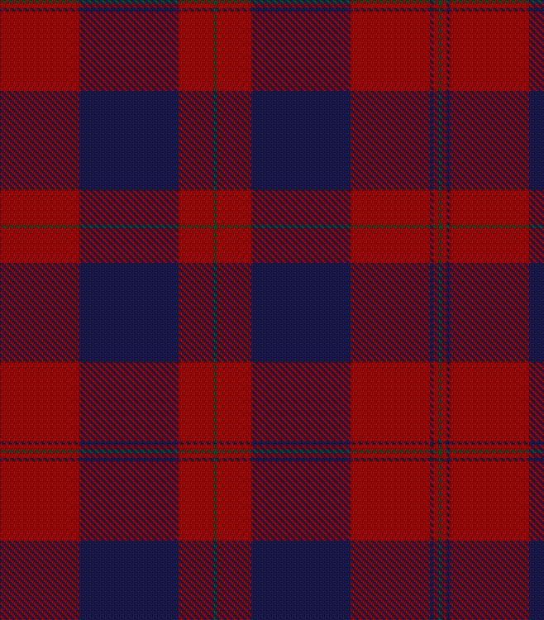
Breath Stacking
In Scotland

Slide 2
Why Undertake Breath-Stacking?
Breath-stacking and assisted breath-stacking are both recommended for our patients when they have respiratory muscle weakness
(NICE 2016)
(British Thoracic Society/Physiotherapy Guidelines) PF >270
These are inexpensive techniques to help keep the lungs elastic,
aid expectoration and reduce distress

Slide 3
Recent Peak Flow snapshot of Half our caseload
73.7 % < 270 (initiate treatment)
OF THESE 29.9% were 160-270
10.5% (their blow was not even strong enough to register)
33.3% were <160 (ineffective cough)

Slide 4
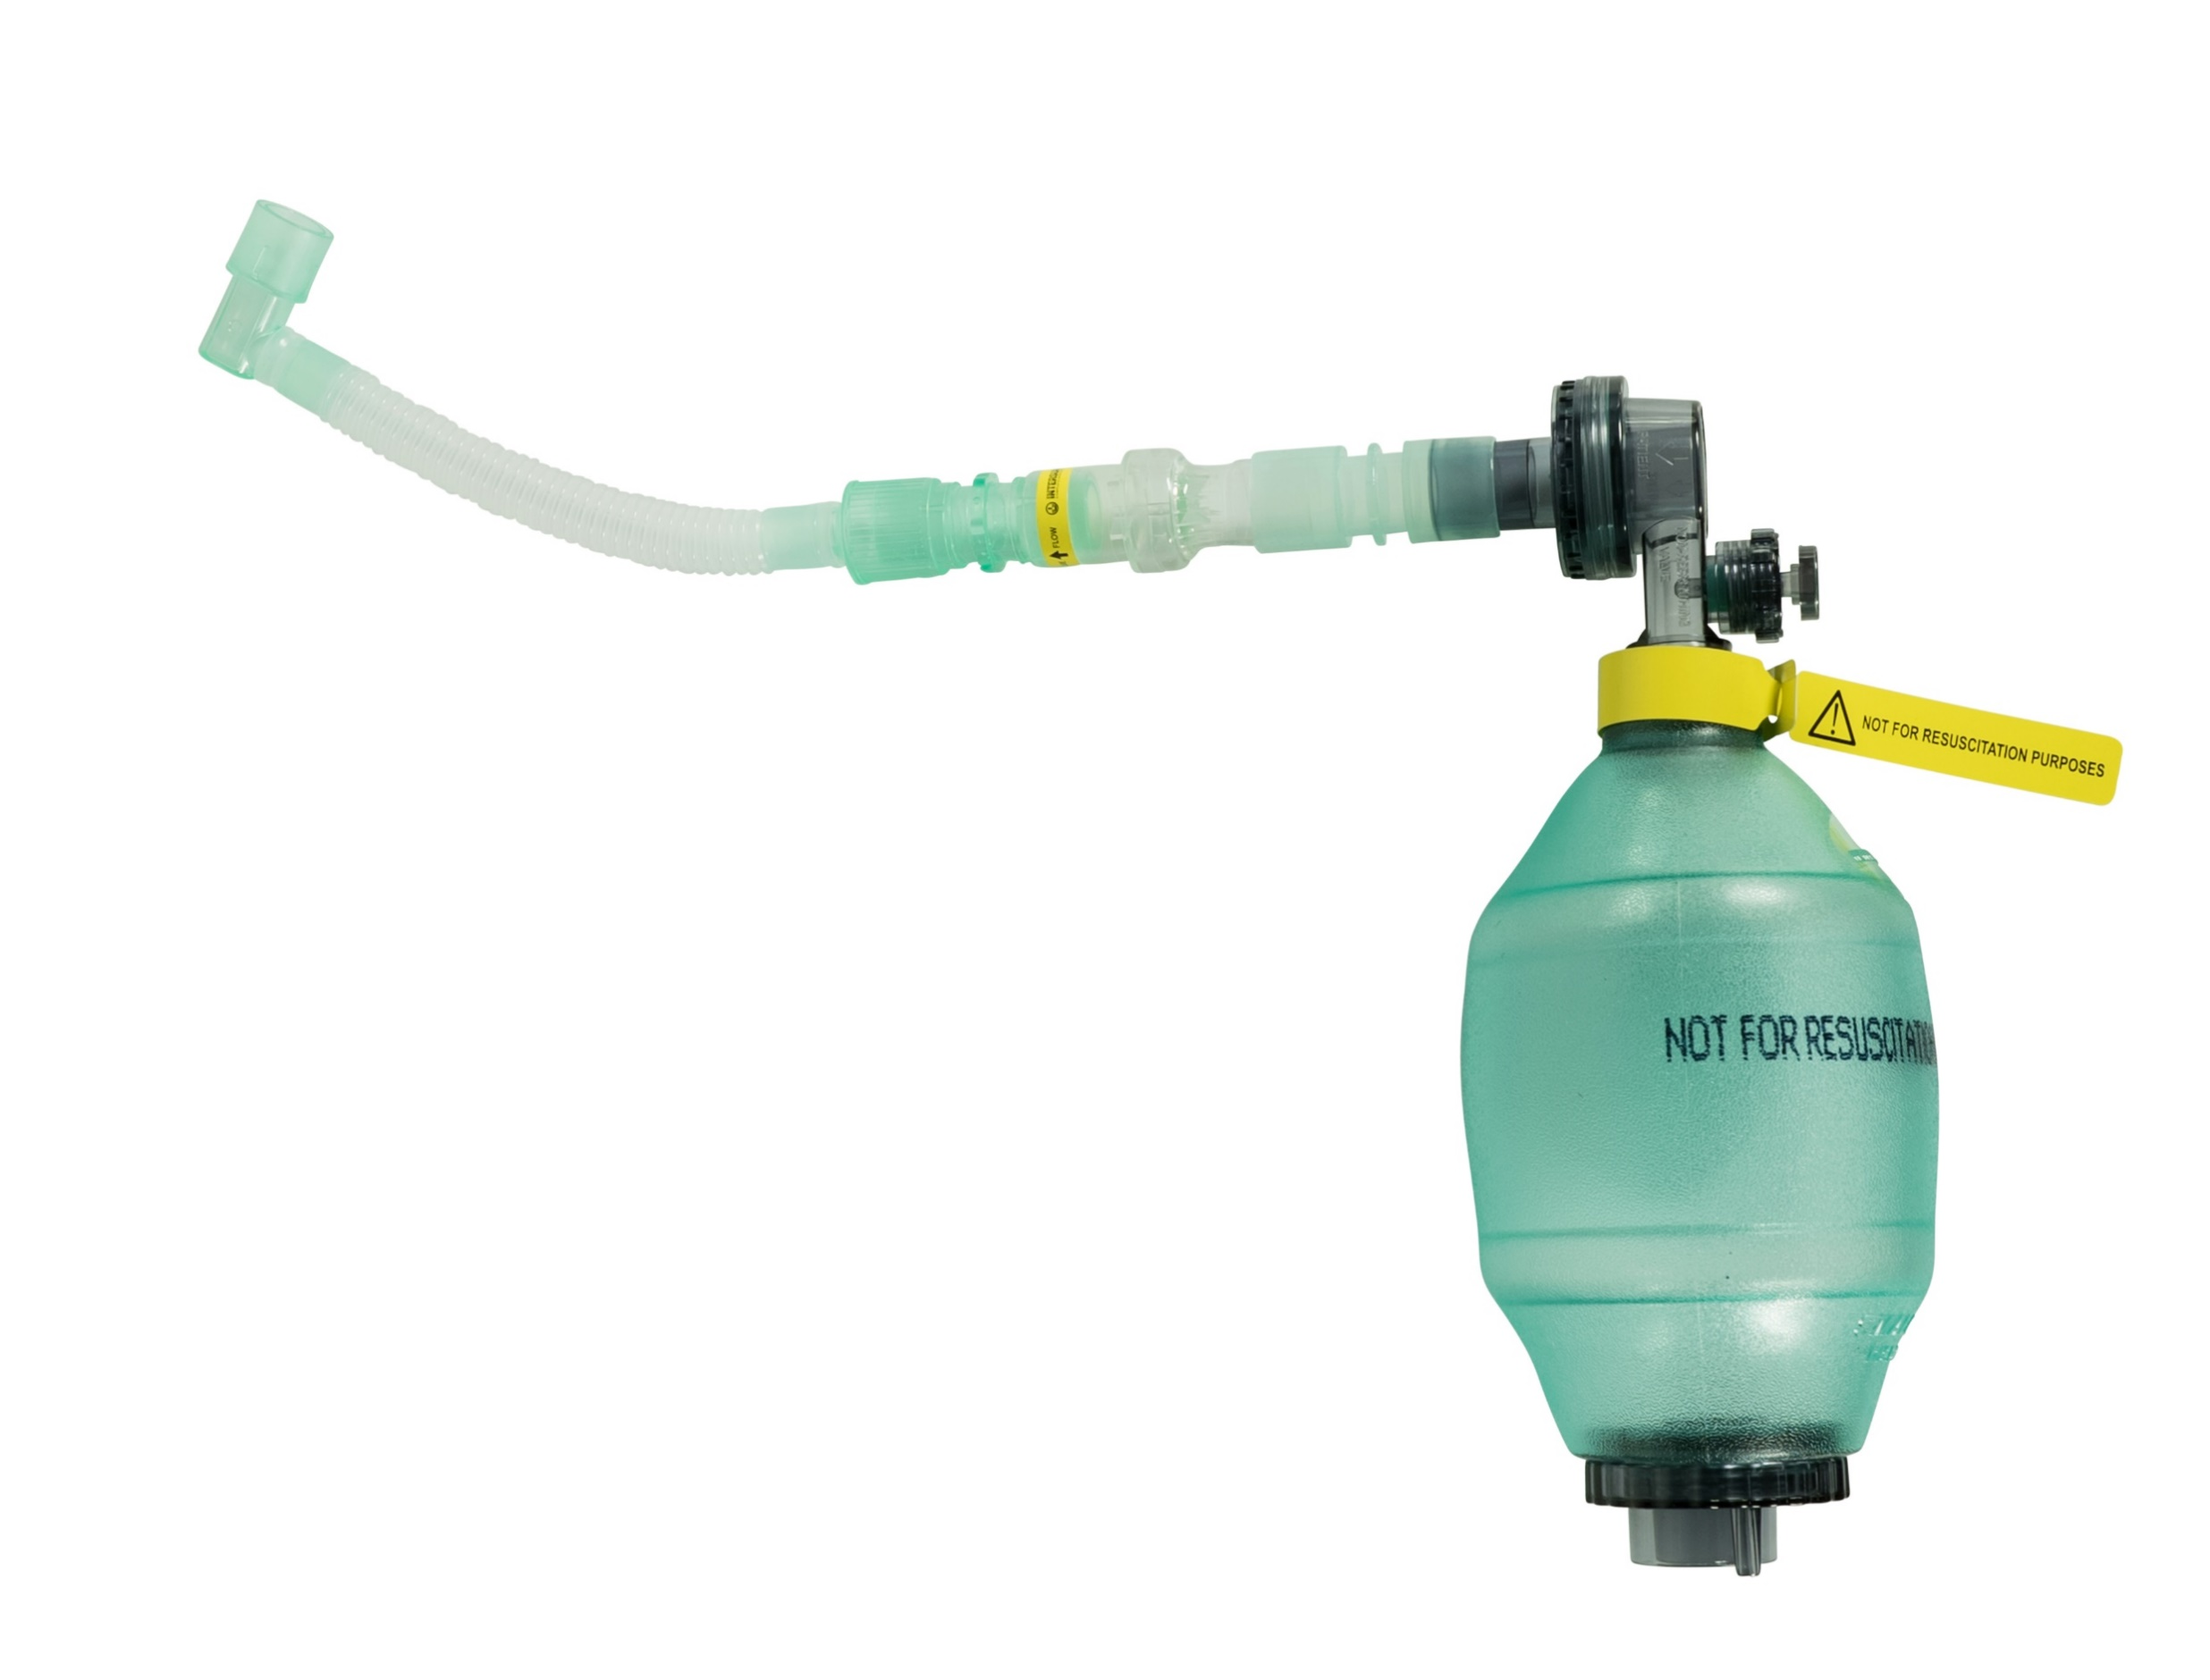
Lung Volume Recruitment Bag (LVR)

Slide 5
Pilot in 2012-14
Introduced breath-stacking to most patients with respiratory weakness
Patients, Carers, Community Physiotherapy staff and Speech and Language Therapists keen to be involved
Produced a range of leaflets alongside the local Respiratory Team

Slide 6
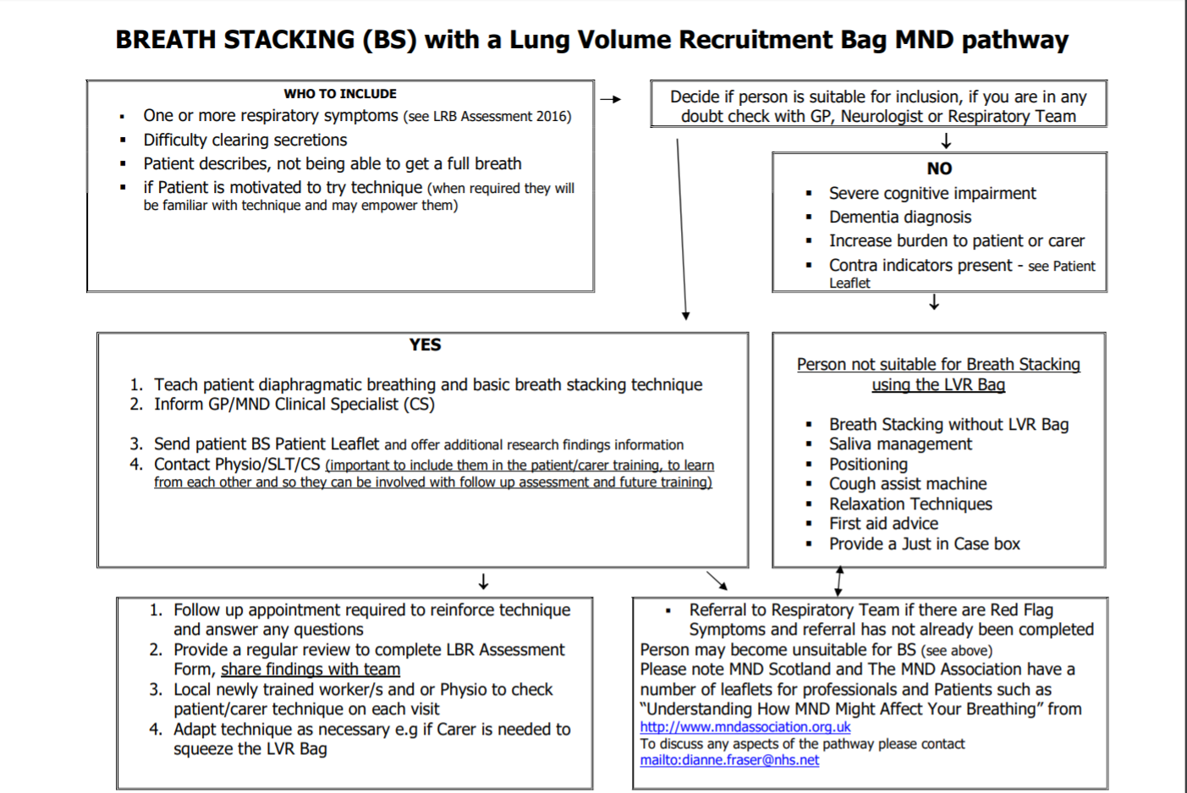
D R A F T

Slide 7
CASCADE TRAINING MODEL to embed learning
“ Tell me and I forget, teach me and I may remember, involve me and I learn.” Benjamin Franklin
1. Arrange joint visit with PT, SLT, patient and carer (also complete a respiratory assessment to raise awareness of potential issues)
2. Demonstrate technique to all (use all learning styles, eg mirroring)
3. Discuss technique taking everyone s views, answer questions and problem solve, if necessary
A brief review of respiratory symptoms and breath stacking technique can now be completed by all 3 professionals visiting patient PLUS awareness of breath stacking in local area increased, and joint visits increased professional links

Slide 8
CASCADE TRAINING MODEL 2
1. Completed a talk to a large group of hospital and community Therapists in the neighbouring Health Board.
2. Additional support and training offered in the future
3. Physiotherapy Team produced a breath stacking champion to disseminate information more widely and carry on training
AIM: TECHNIQUE IS EMBEDDED INTO THE THERAPUTIC TOOLKIT
I am about to complete a national survey questionnaire which should highlight whether these models have been effective.

Slide 9
2019 Scoping Review
1. Trained in the JBI method, and receiving ongoing support from tutors
2. Produced a protocol and about to register it soon
3. Then complete a scoping/mapping exercise to explore all data available on breath stacking

Slide 10
How Can You Help?
dianne.fraser@nhs.net

Slide 11
2019 Breath Stacking Research
Aim: every appropriate pwMND will have
breath stacking as a treatment option
Consensus WHO is this appropriate for
What are the safety implications
The therapist, patient, carer views
What training is available/is required
Investigate practicalities
Complete a Package of Solutions
Complete a Professional Tool Kit
Gordon Aikman Grant

Slide 12
Thanks to..
Scottish Parliament
Gordon Aikman and Team
The Care-MND Platform
MND Scotland Librarian
Physio and Speech Therapy Teams
National Clinical Specialist Team
The Euan McDonald Research Centre
And a final thank you to the Scottish Tartan Registry for their permission to replicate some of the many Fraser tartans!

Slide 13
dianne.fraser@nhs.net

